Slide 1
CS6120
Kenneth Church
https://kwchurch.github.io

Slide 2
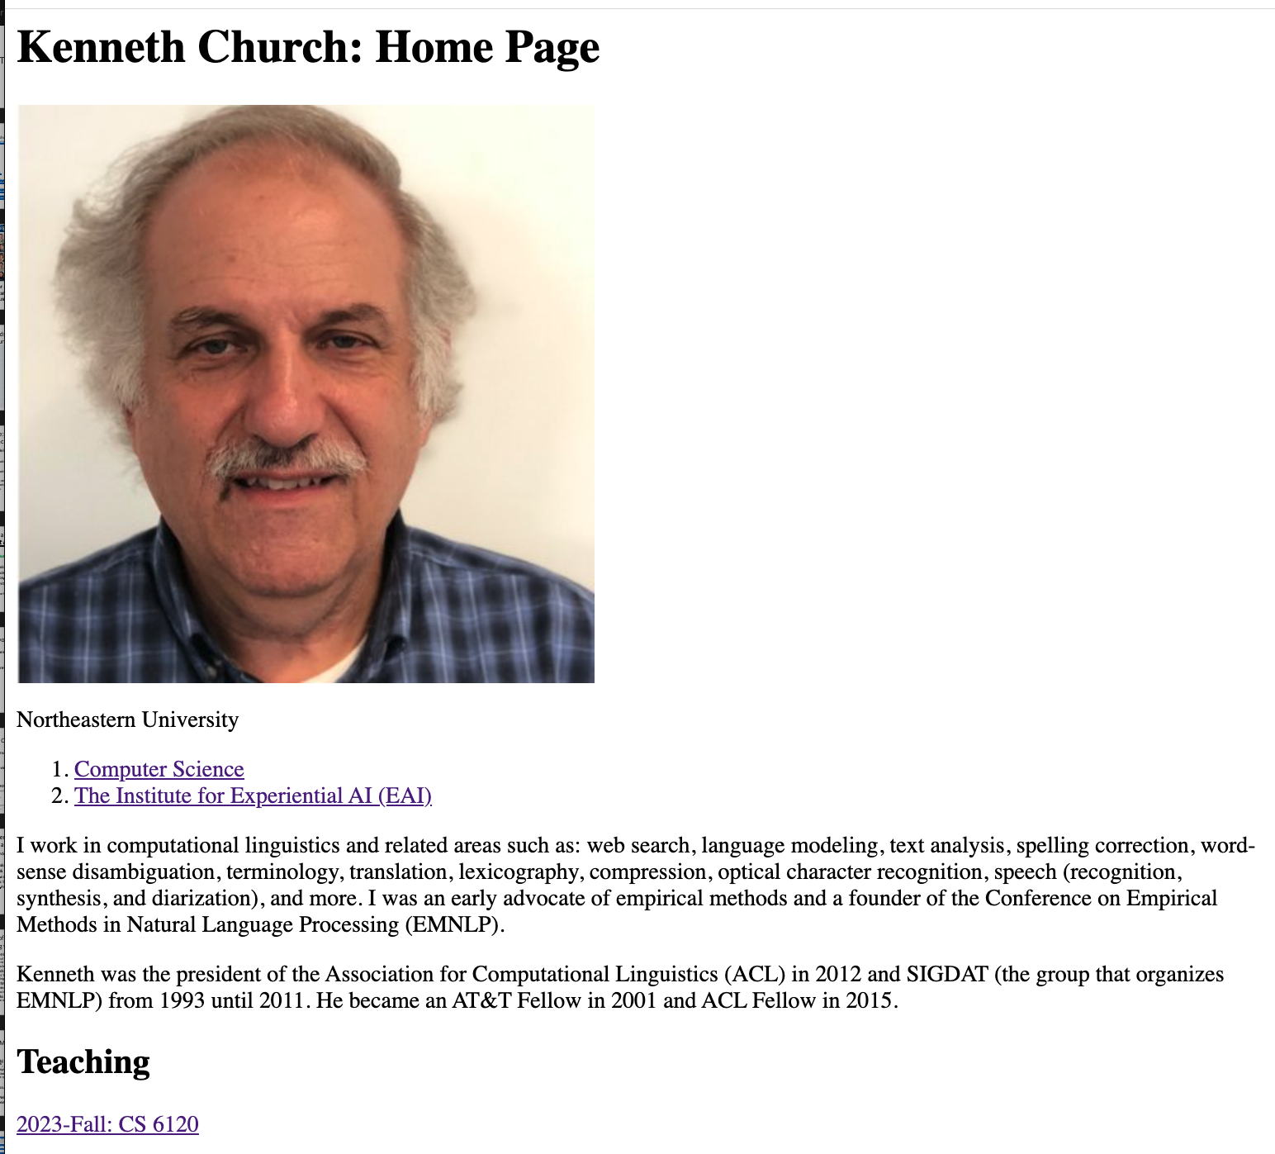
https://kwchurch.github.io

Slide 3
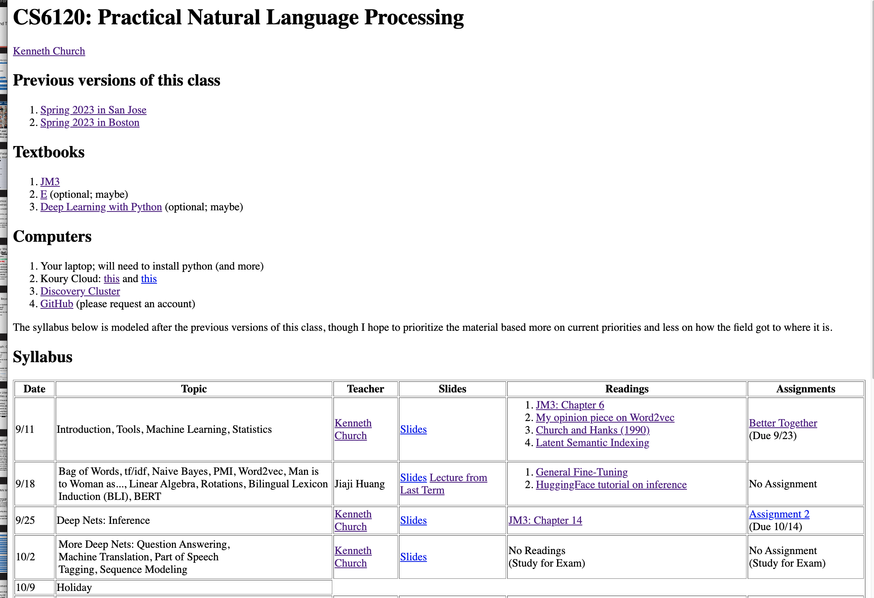

Slide 4
Goals for this class
Prioritize material based
more on current priorities and
less on how
the field got to where it is
Start with what’s hot now
Deep nets and Bots
End with
Topics that may become great (again)
Success:
Students have confidence that
they can learn
what you need to know
just in time
(when you need to know it)
Learn to swim by
jumping into deep end
Won’t let you drown
(but no spoon feeding)

Slide 5
Grading, Accessibility, Tardiness, Effort, etc.
Final Project:
Encourage Team Efforts
Proposal & Final Presentation
Coding
Written Presentation
Oral Presentation
Mid-Term Exam
Open book, computer, network
If you can find a way to use ChatGPT to do the exam for you
Shame on me!
Flipped Classroom
Lectures → Recitations
Homework → Readings/Lectures
Assignments → Exercises
First Assignment → Calibration
Expect wide range of backgrounds
Don’t be discouraged if others find it too easy (and you don’t)
I want to see effort/progress
If they already know it
They can’t learn it
Readings
Intended to prepare for next class

Slide 6
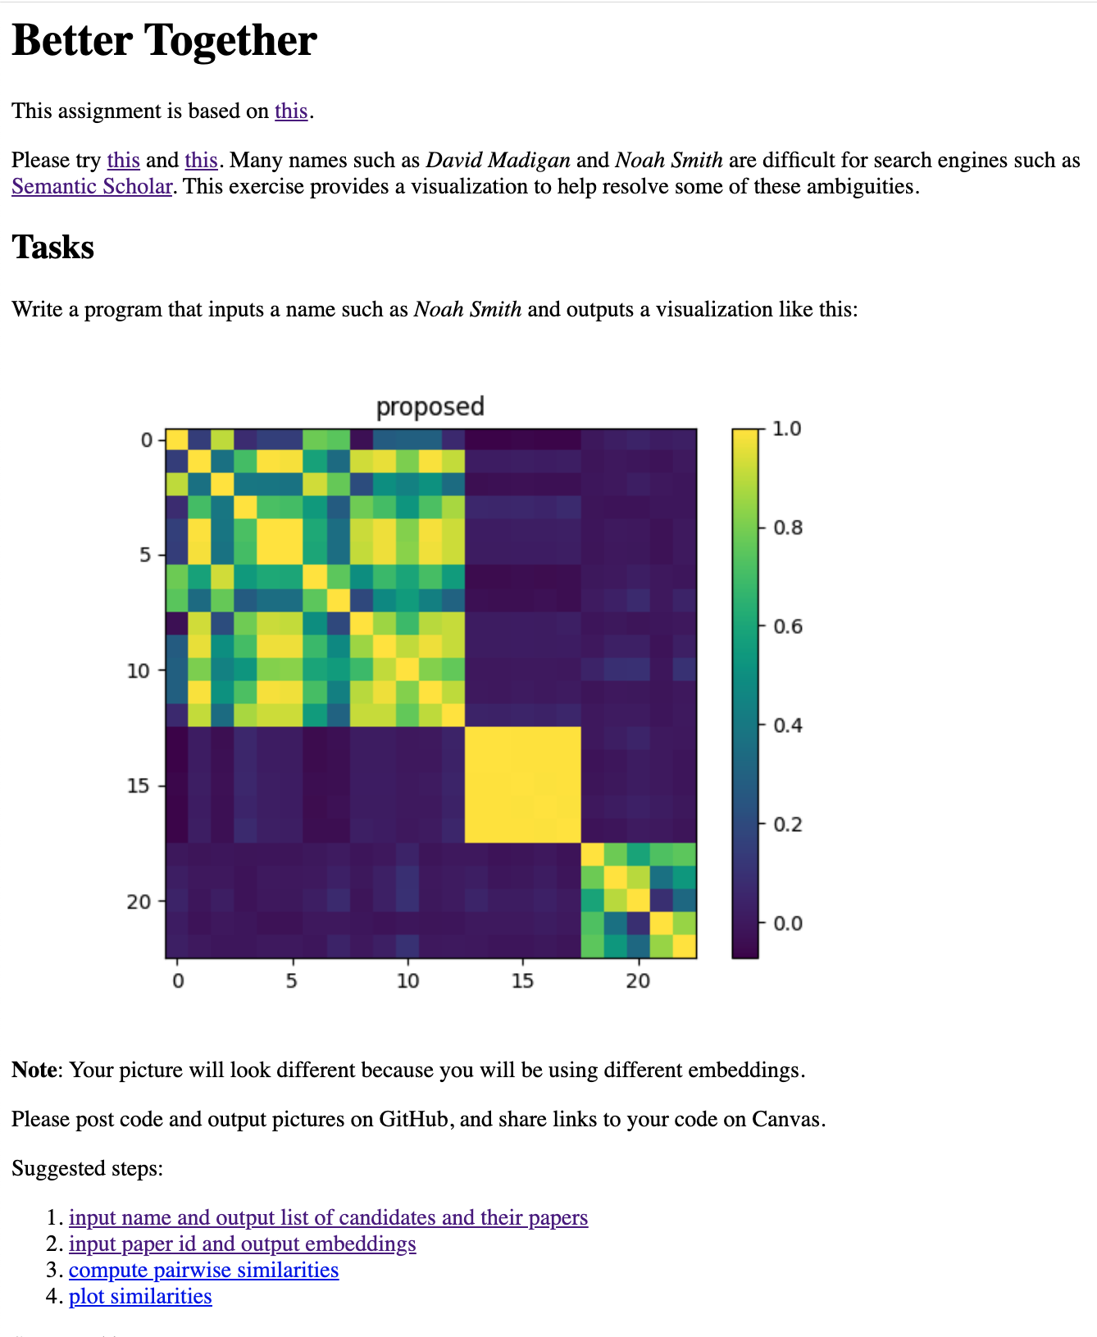
Better Together Homework
Purpose(s)
Motivate
What’s hot: deep nets, embeddings
and what’s not: python, pip, etc.
Calibration
I’m clueless about…
Avoid getting into details
What is an embedding?
What is a deep net?
Little Languages
Suggest that deep nets are like regression

Slide 7
Little Languages

Slide 8
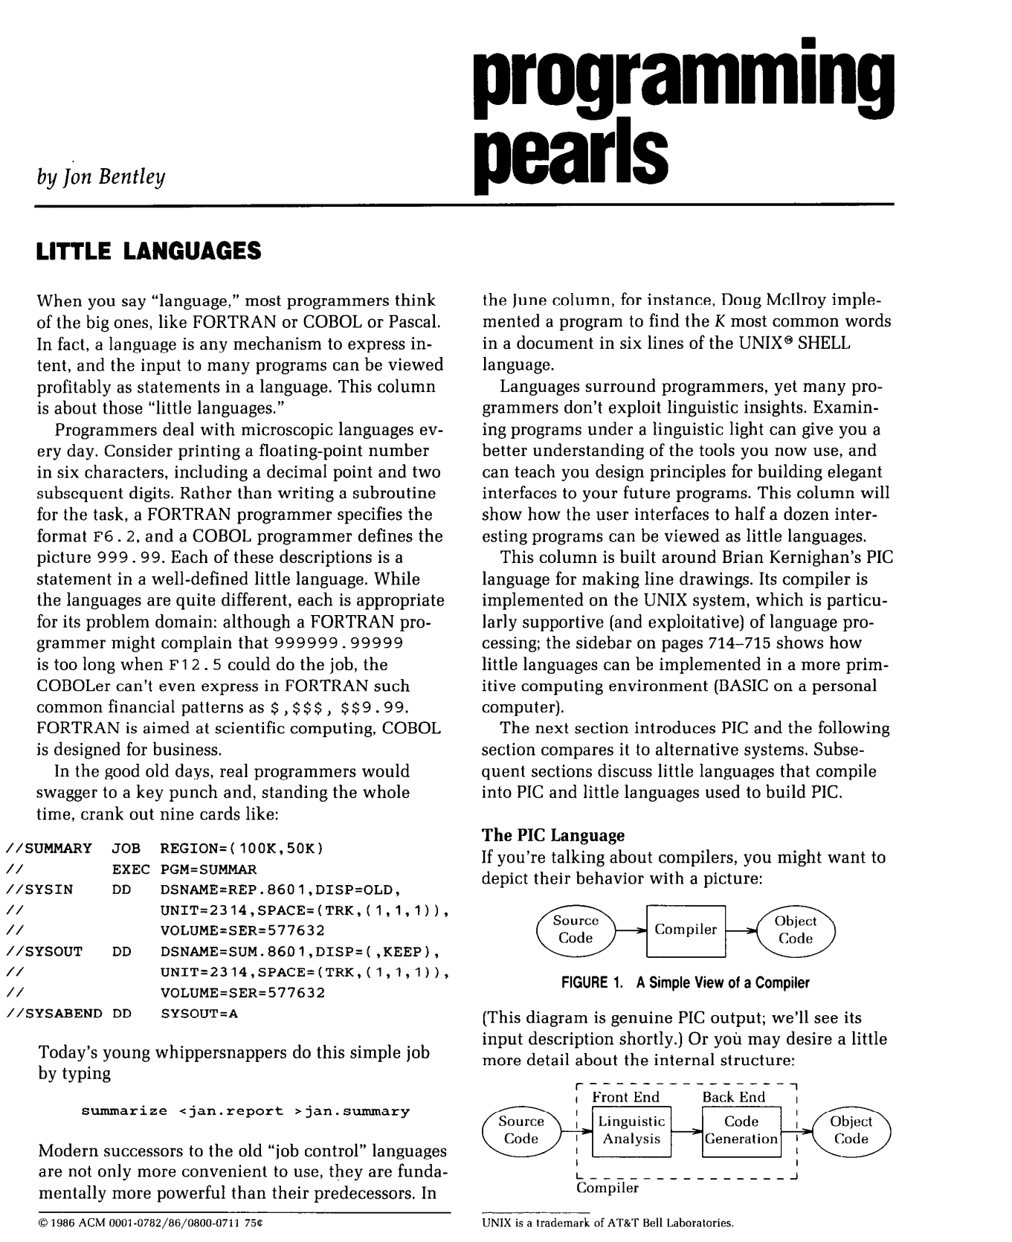
Little Languages (from Unix)
Bentley (CACM-1986)

Slide 9
We propose gft, a Little Language
In the good old days,
real programmers would copy a few hundred lines of
PyTorch from HuggingFace
and modify as necessary to change
models,
datasets,
task,
etc.
With gft, 100s of lines → 1-line
More accessible to masses
(including non-programmers)

Slide 10
Standard 3-Step Recipe
Step | Description | Time | Hardware
1
2
3 | Inference (predict) | Seconds/Minutes | 0+ GPUs
Easy

Slide 11
Standard 3-Step Recipe
Most users should not do this themselves
Step | Description | Time | Hardware
1 | Pre-Training | Days/Weeks | Large GPU cluster
2
3 | Inference (predict) | Seconds/Minutes | 0+ GPUs

Slide 12
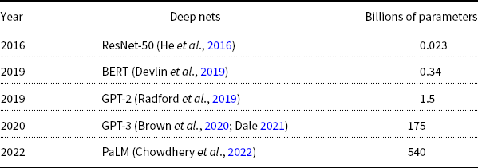
Hard: Pre-Training Large Language Models (LLMs)
GPT-3
PaLM
GPT-2
BERT
ResNet
Most users should not invest in pretraining
because growth (& costs) are out of control

Slide 13
Standard 3-Step Recipe
Step | Description | Time | Hardware
1 | Pre-Training | Days/Weeks | Large GPU cluster
2 | Fine-Tuning (fit) | Hours/Days | 1+ GPUs
3 | Inference (predict) | Seconds/Minutes | 0+ GPUs
Not Hard

Slide 14

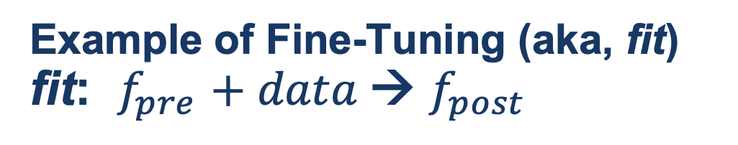
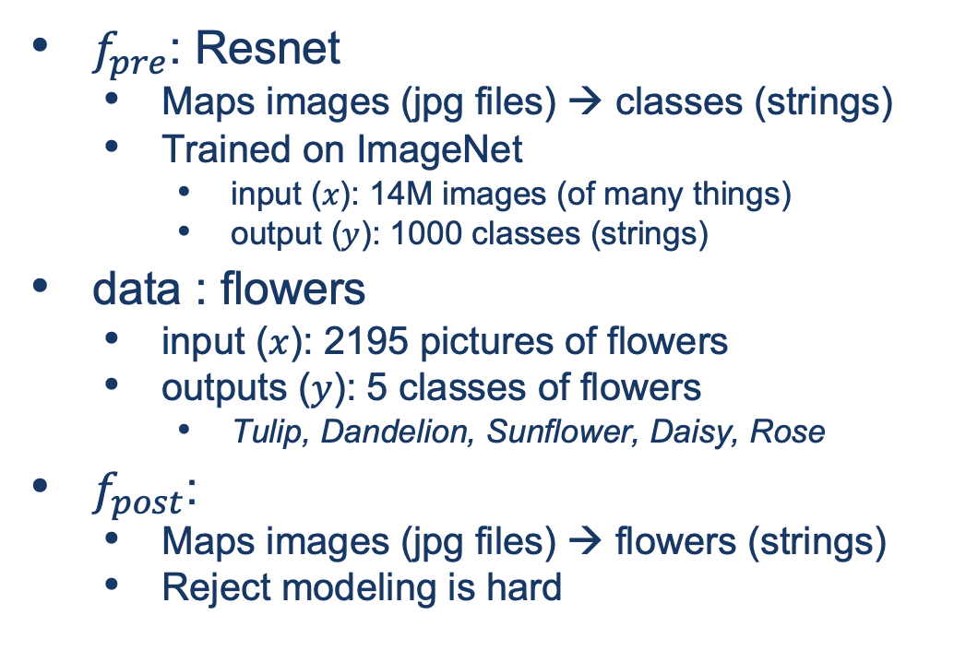
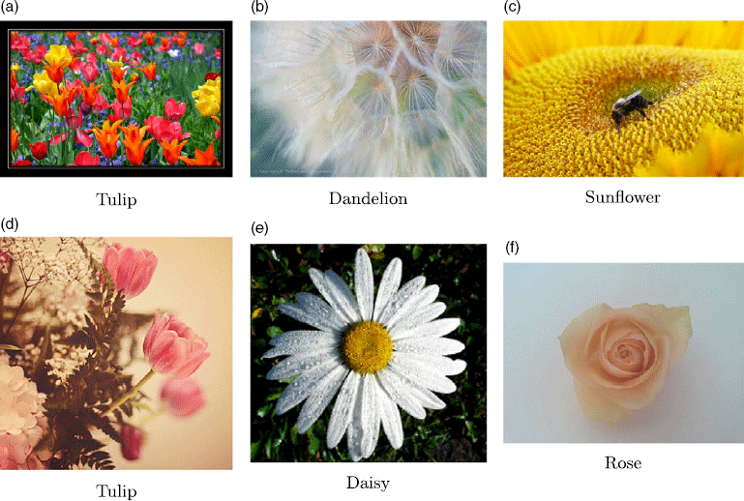
Guide Book App

Slide 15
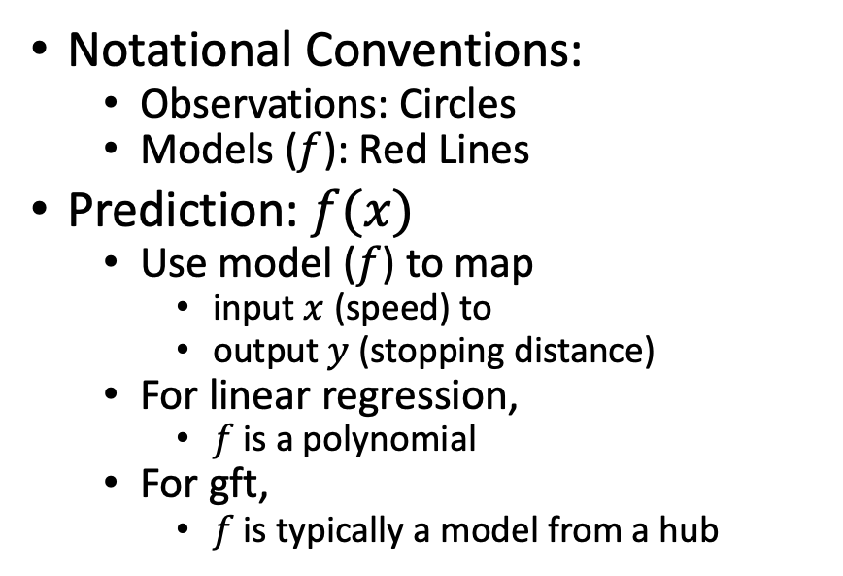
Fine-Tuning (Fit) in R (Statistics Package)
Make deep nets look like regression
(Not much programming)
Black Points:
cars dataset
Notational Conventions:
Observations: Circles
Models ($f$): Red Lines
Prediction: $f(x)$
Use model ($f$) to map
input $x$ (speed) to
output $y$ (stopping distance)
For linear regression,
$f$is a polynomial
For gft,
$f$is typically a model from a hub
Red Line:
Model (f)

Slide 16
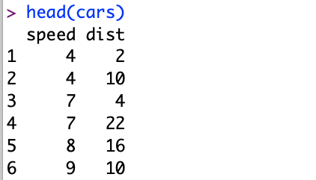
Datasets Example: Cars
Two Columns:
cars$speed
cars$dist

Slide 17
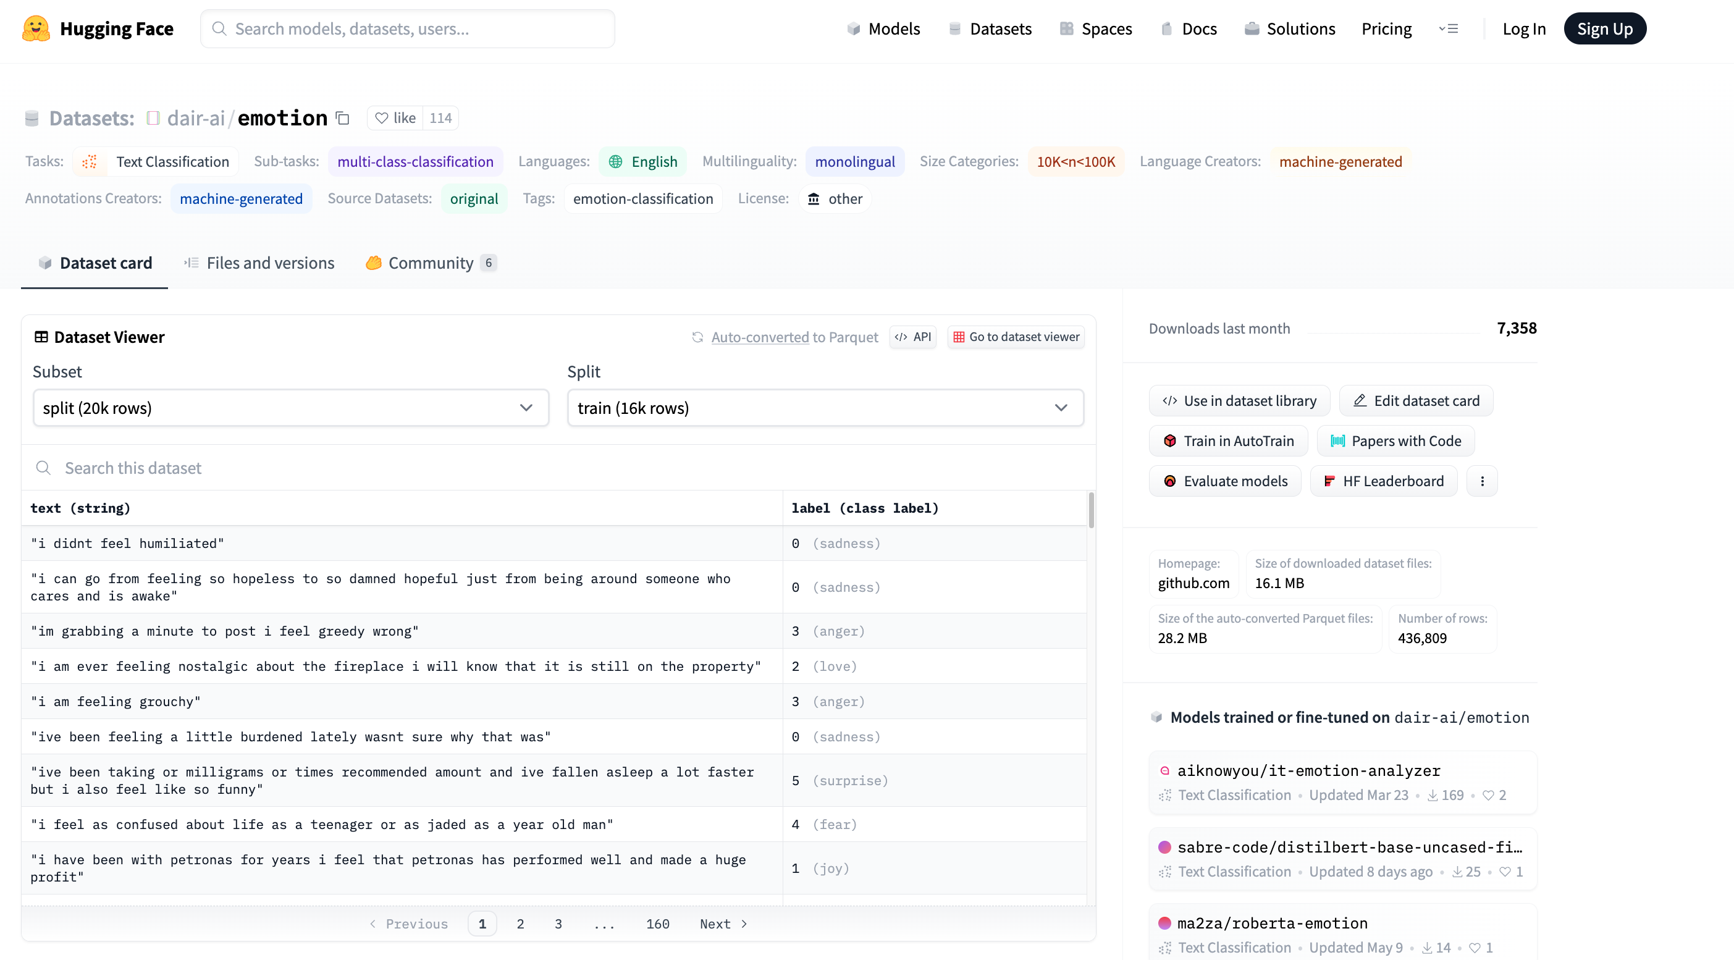


Example of Datasets in HuggingFace https://huggingface.co/datasets/dair-ai/emotion
$$x$$
$$y$$

Slide 18
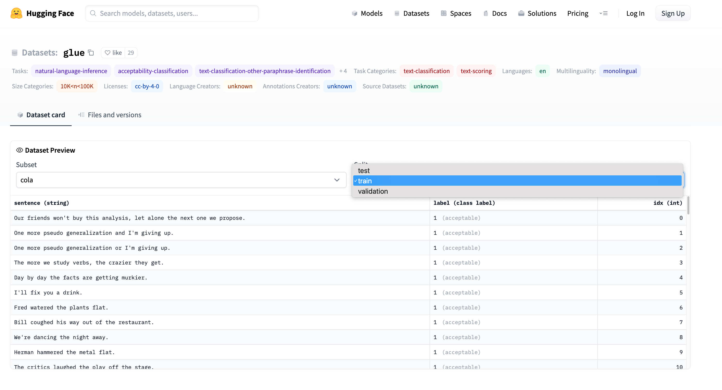
Emotion → GLUE (Cola) https://huggingface.co/datasets/glue/viewer/cola/train
Terminology: Splits
Terminology: Subset

Slide 19
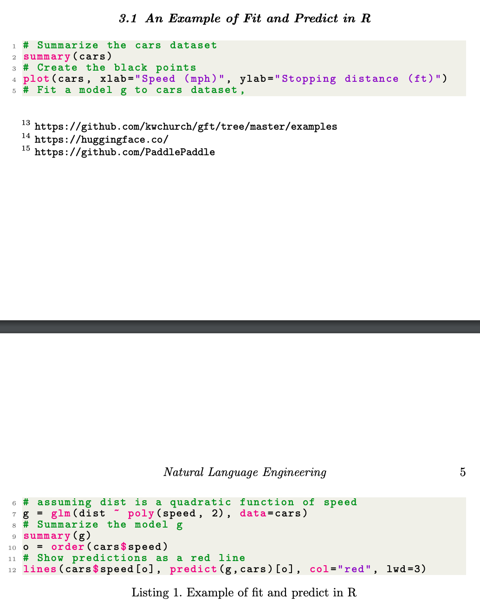
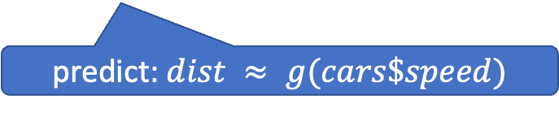
glm (General Linear Models) in R (and Sklearn)
glm: fit poly model with data
predict: $dist ≈ g(cars\$speed)$

Slide 20
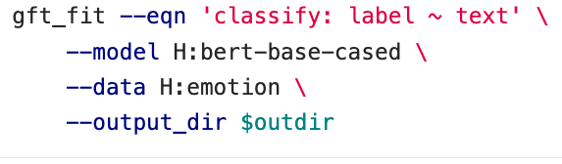
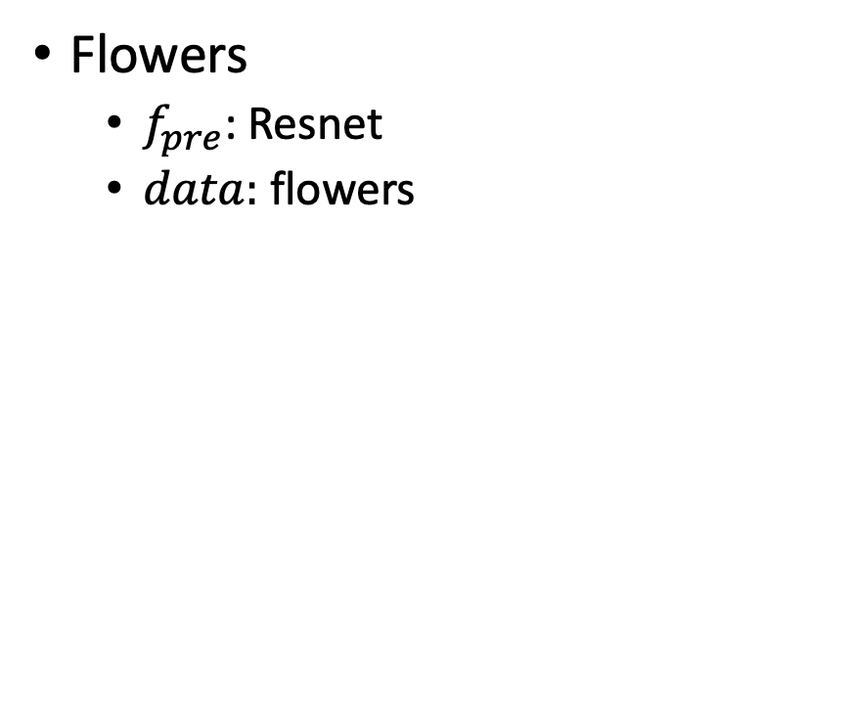
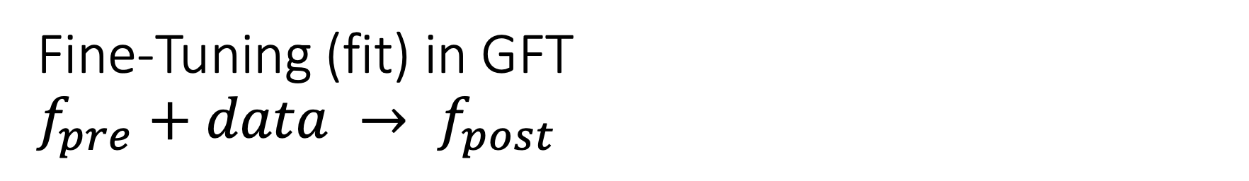
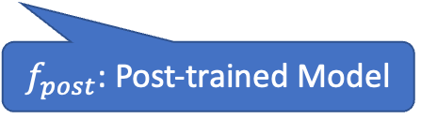
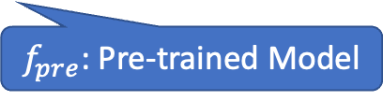
Fine-Tuning (fit) in GFT $f_{pre}+data → f_{post}$
Flowers
$f_{pre}$: Resnet
$data:$flowers
$f_{pre}$: Pre-trained Model
$f_{post}$: Post-trained Model
Fine-Tuning (fit) in R

Slide 21
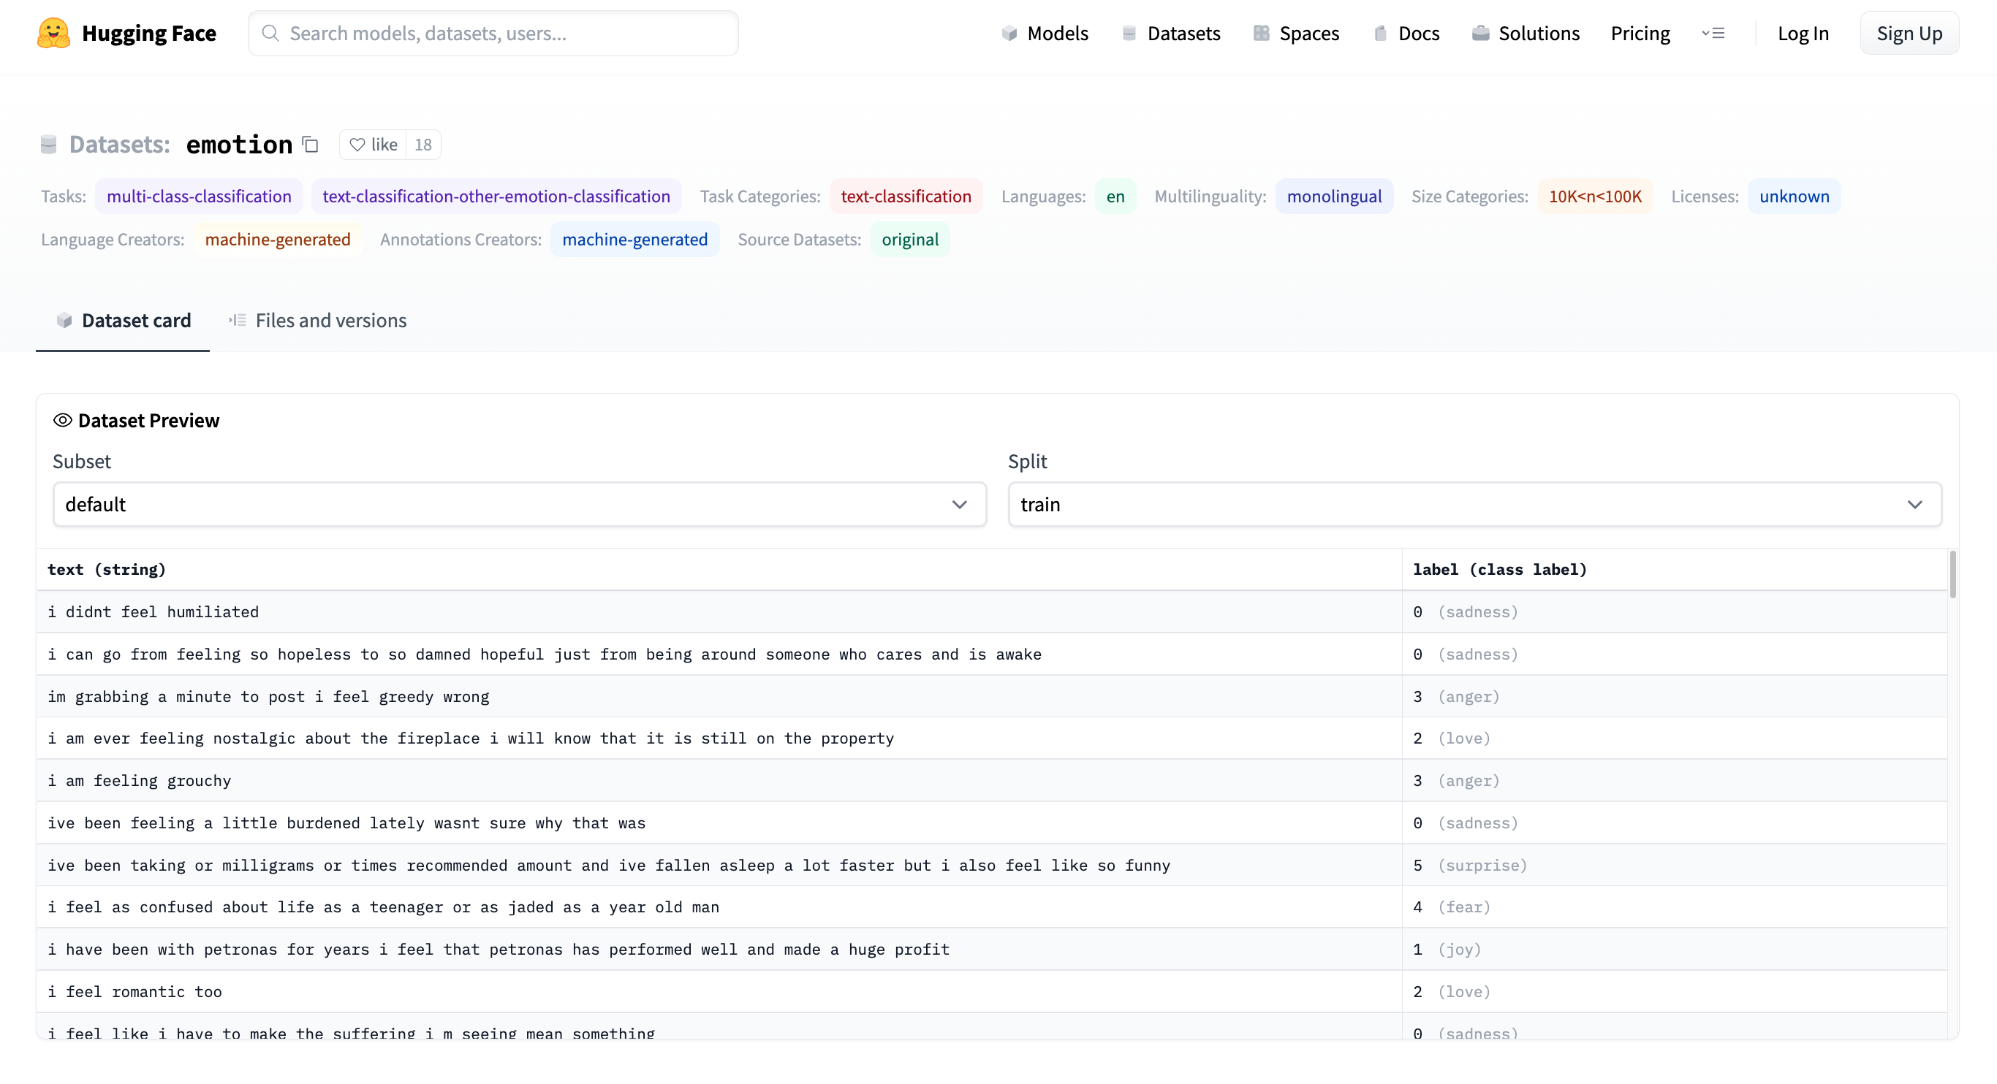

Emotion Dataset $$classify:label\sim text$$
Task/Loss
Columns
Columns
Row

Slide 22
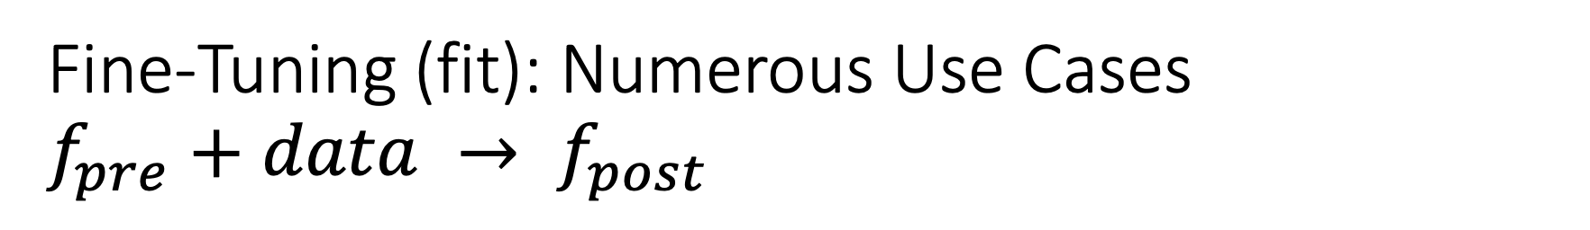
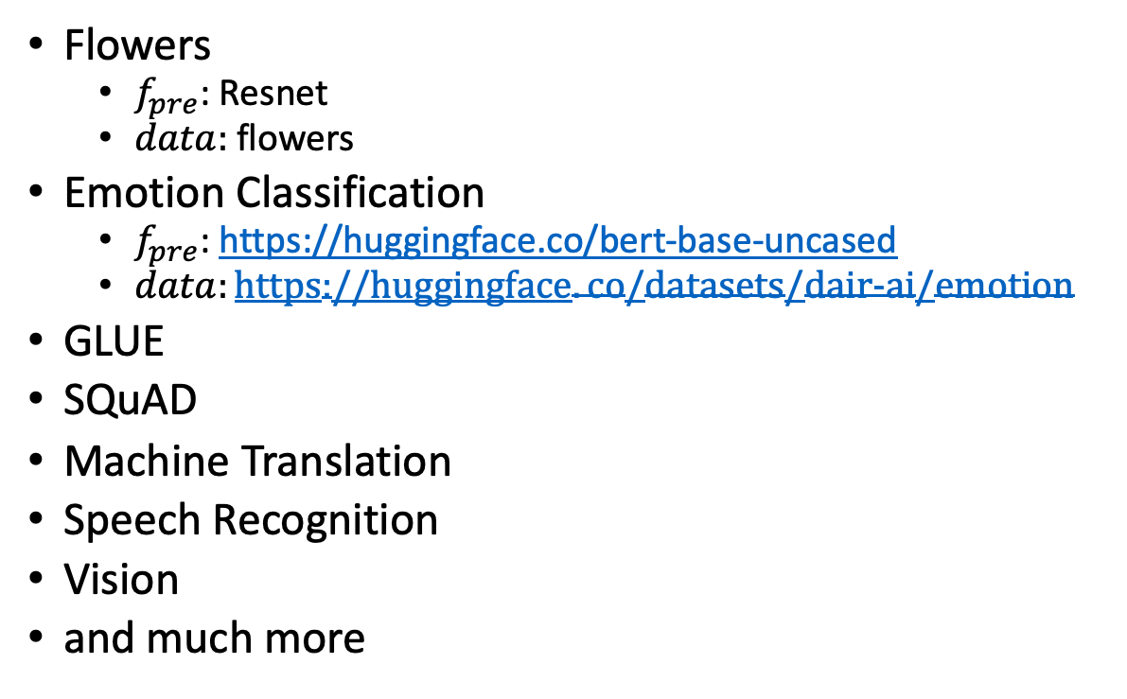
Fine-Tuning (fit): Numerous Use Cases $f_{pre}+data → f_{post}$
Flowers
$f_{pre}$: Resnet
$data:$flowers
Emotion Classification
$f_{pre}$: https://huggingface.co/bert-base-uncased
$data:https://huggingface.co/datasets/dair−ai/emotion$
GLUE
SQuAD
Machine Translation
Speech Recognition
Vision
and much more
$f_{pre}$: Pre-trained Model
$f_{post}$: Post-trained Model
Fine-Tuning (fit) in R

Slide 23
GLUE Subsets
GLUE COLA SUBSET
Sentence | Label
Bill sang himself to sleep. | 1 (acceptable)
Bill squeezed the puppet through the hole. | 1 (acceptable)
Bill sang Sue to sleep. | 1 (acceptable)
The elevator rumbled itself to the ground. | 0 (unacceptable)
If the telephone rang, it could ring itself silly. | 1 (acceptable)
She yelled hoarse. | 0 (unacceptable)
Ted cried to sleep. | 0 (unacceptable)
The tiger bled to death. | 1 (acceptable)
Subset | Dataset
COLA | H:glue,cola
SST2 | H:glue,sst2
WNLI | H:glue,wnli
MRPC | H:glue,mrpc
QNLI | H:glue,qnli
QQP | H:glue,qqp
SSTB | H:glue,sstb
MNLI | H:glue,mnli

Slide 24
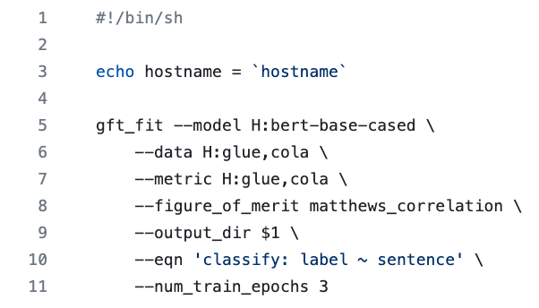
GFT Program for COLA
GLUE COLA SUBSET
Sentence | Label
Bill sang himself to sleep. | 1 (acceptable)
Bill squeezed the puppet through the hole. | 1 (acceptable)
Bill sang Sue to sleep. | 1 (acceptable)
The elevator rumbled itself to the ground. | 0 (unacceptable)
If the telephone rang, it could ring itself silly. | 1 (acceptable)
She yelled hoarse. | 0 (unacceptable)
Ted cried to sleep. | 0 (unacceptable)
The tiger bled to death. | 1 (acceptable)
https://github.com/kwchurch/gft/blob/master/examples/fit_examples/model.HuggingFace/language/data.HuggingFace/glue/cola.sh

Slide 25
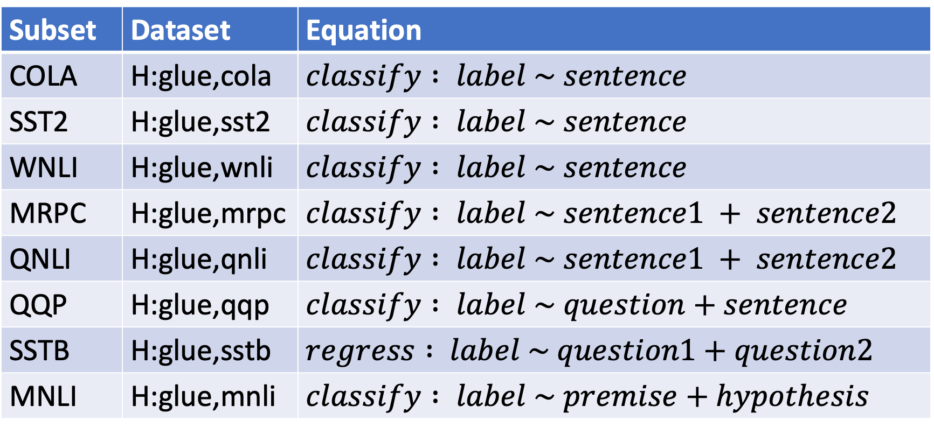
Simple Equations Cover Many Cases of Interest GLUE: A Popular Benchmark
Subset | Dataset | Equation
COLA | H:glue,cola | $$classify : label \sim sentence$$
SST2 | H:glue,sst2 | $$classify : label \sim sentence$$
WNLI | H:glue,wnli | $$classify : label \sim sentence$$
MRPC | H:glue,mrpc | $$classify : label \sim sentence1 + sentence2$$
QNLI | H:glue,qnli | $$classify : label \sim sentence1 + sentence2$$
QQP | H:glue,qqp | $$classify : label \sim question+sentence$$
SSTB | H:glue,sstb | $$regress : label \sim question1+question2$$
MNLI | H:glue,mnli | $$classify : label \sim premise+hypothesis$$

Slide 26
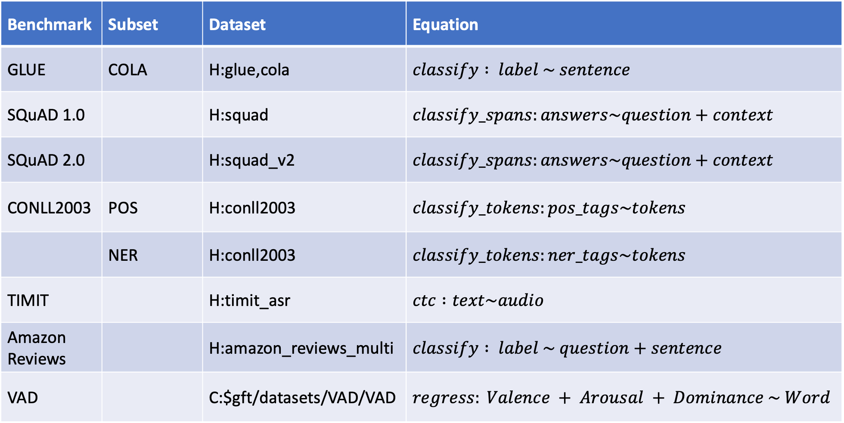

Equation Keywords $≈$ Pipeline Tasks
Benchmark | Subset | Dataset | Equation
GLUE | COLA | H:glue,cola | $$classify : label \sim sentence$$
SQuAD 1.0 |  | H:squad | $$classify_spans:answers\sim question+context$$
SQuAD 2.0 |  | H:squad_v2 | $$classify_spans:answers\sim question+context$$
CONLL2003 | POS | H:conll2003 | $$classify_tokens:pos_tags\sim tokens$$
 | NER | H:conll2003 | $$classify_tokens:ner_tags\sim tokens$$
TIMIT |  | H:timit_asr | $$ctc :text\sim audio$$
Amazon Reviews |  | H:amazon_reviews_multi | $$classify : label \sim question+sentence$$
VAD |  | C:$gft/datasets/VAD/VAD | $$regress: Valence + Arousal + Dominance \sim Word$$

Slide 27
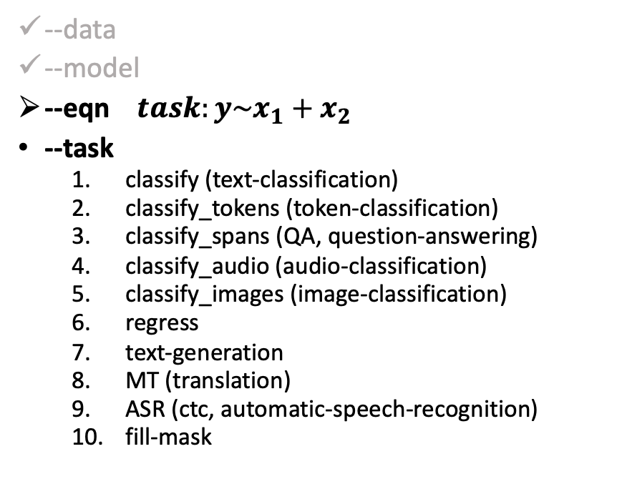
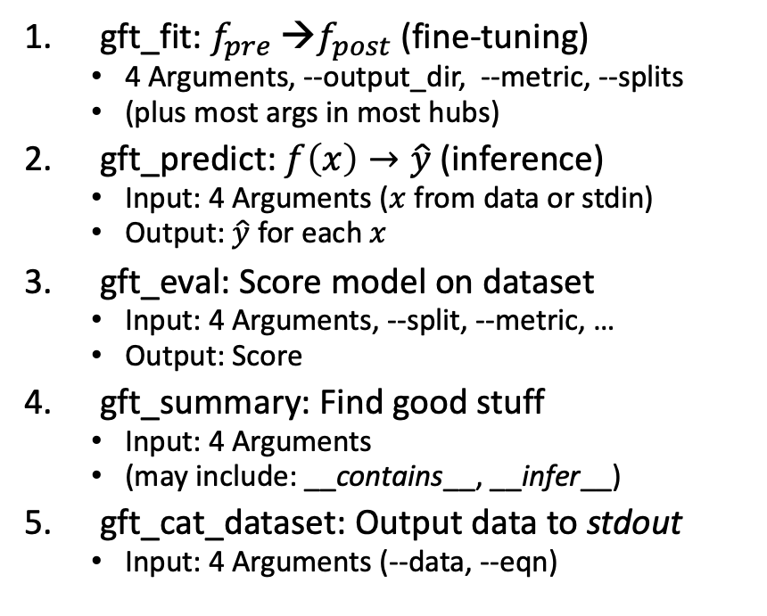
gft Cheat Sheet (General Fine-Tuning)
4+1 Functions
4 Arguments
gft_fit: $f_{pre}$ →$f_{post}$(fine-tuning)
4 Arguments, --output_dir, --metric, --splits
(plus most args in most hubs)
gft_predict: $f\left(x\right)→\hat{y}$ (inference)
Input: 4 Arguments ($x$ from data or stdin)
Output: $\hat{y}$ for each $x$
gft_eval: Score model on dataset
Input: 4 Arguments, --split, --metric, …
Output: Score
gft_summary: Find good stuff
Input: 4 Arguments
(may include: __contains__, __infer__)
gft_cat_dataset: Output data to stdout
Input: 4 Arguments (--data, --eqn)
--data
--model
--eqn $task:y\sim x_{1}+x_{2}$
--task
classify (text-classification)
classify_tokens (token-classification)
classify_spans (QA, question-answering)
classify_audio (audio-classification)
classify_images (image-classification)
regress
text-generation
MT (translation)
ASR (ctc, automatic-speech-recognition)
fill-mask

Slide 28
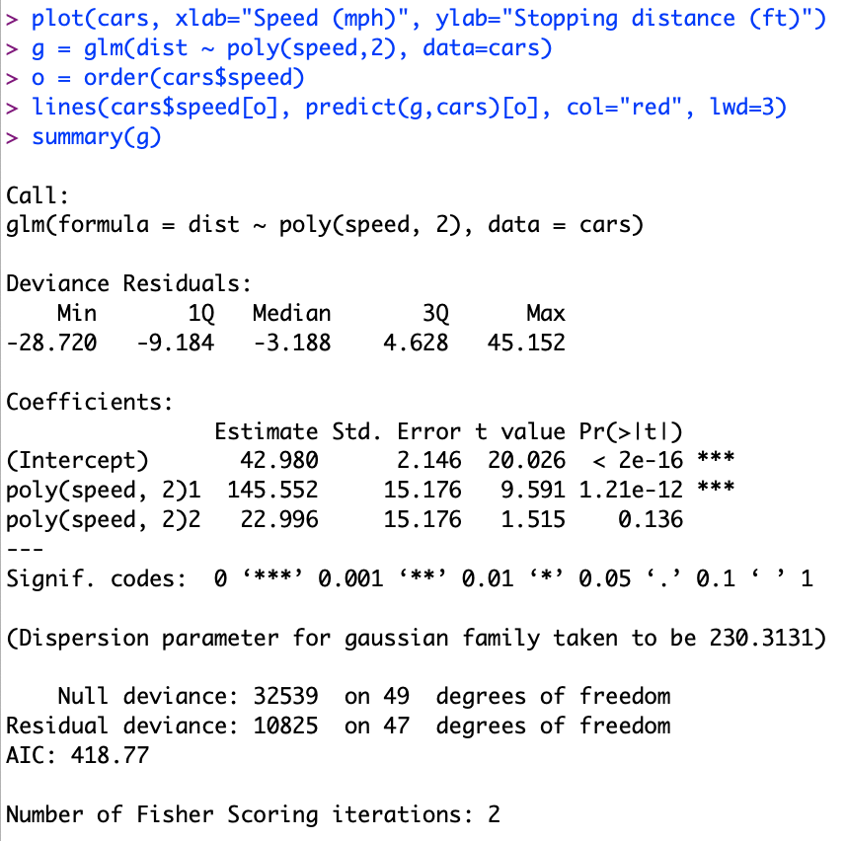
Regression in R: Summarize (almost) anything
Fit a model (g) to data (cars)

Slide 29
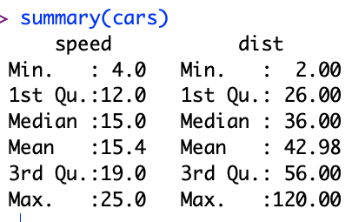
Regression in R: Summarize (almost) anything

Slide 30
Regression in R: Summarize (almost) anything
Fit a model (g) to data (cars)
Predict
Summarize a model (g)
Opportunity to Improve g

Slide 31
gft_summary
Summarize almost anything
Models
Datasets

Slide 32





Tasks
$$y∈\left\{0,1,2,…\right\}$$
classify, text-classification
regress
QA, Question Answering, classify spans
token classification
NER (Named Entity Recognition)
POS (Part of Speech Tagging)
translation, MT
ASR, Automatic Speech Recognition, ctc
$y∈ℝ$ or $y∈ℝ^{N}$
$y$ for each start/end of span
$y$ for each token
$y$ for each phoneme

Slide 33
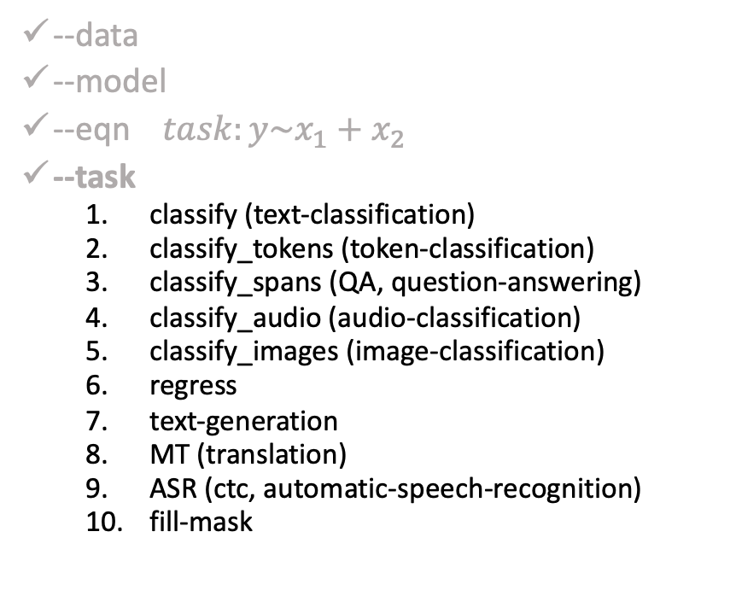
gft Cheat Sheet (General Fine-Tuning)
4+1 Functions
4 Arguments
gft_fit: $f_{pre}$ →$f_{post}$(fine-tuning)
4 Arguments, --output_dir, --metric, --splits
(plus most args in most hubs)
gft_predict: $f\left(x\right)→\hat{y}$ (inference)
Input: 4 Arguments ($x$ from data or stdin)
Output: $\hat{y}$ for each $x$
gft_eval: Score model on dataset
Input: 4 Arguments, --split, --metric, …
Output: Score
gft_summary: Find good stuff
Input: 4 Arguments
(may include: __contains__, __infer__)
gft_cat_dataset: Output data to stdout
Input: 4 Arguments (--data, --eqn)
--data
--model
--eqn $task:y\sim x_{1}+x_{2}$
--task
classify (text-classification)
classify_tokens (token-classification)
classify_spans (QA, question-answering)
classify_audio (audio-classification)
classify_images (image-classification)
regress
text-generation
MT (translation)
ASR (ctc, automatic-speech-recognition)
fill-mask

Slide 34
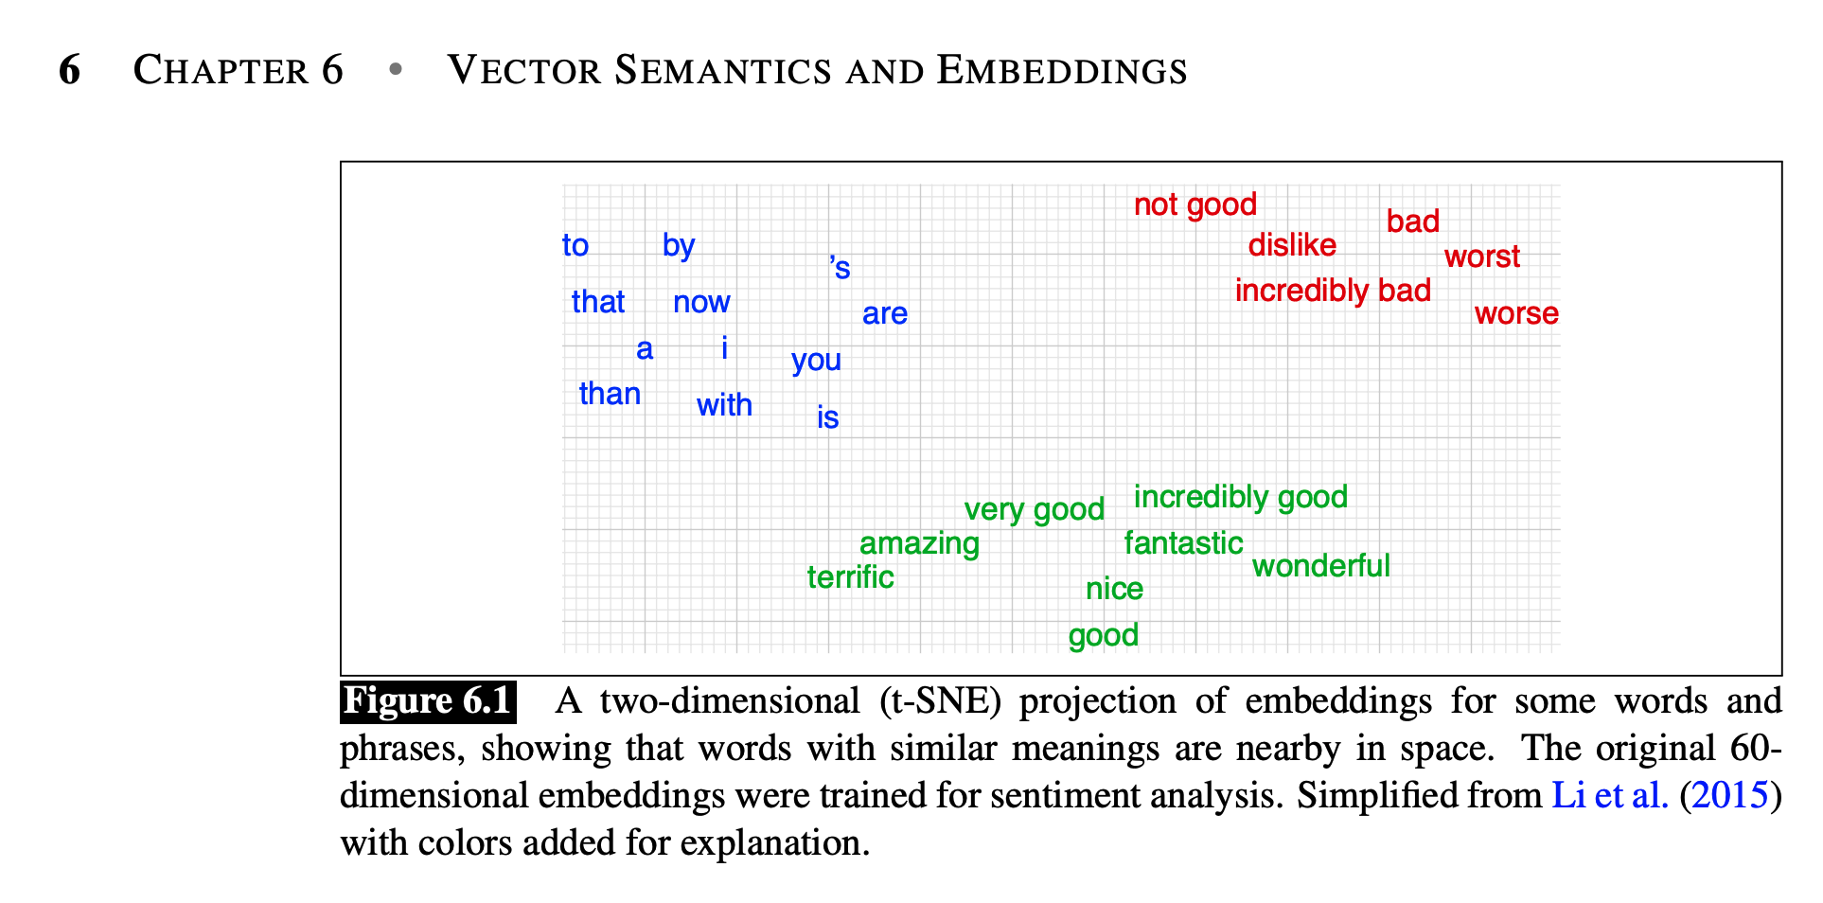
Machine Learning Before Deep Nets
Collocation
PMI (Church & Hanks, 1990)
Word2vec (Factored PMI)
Anything to vec
Homework: Better Together
Doc2vec (in many ways)
Cosine similarity
Similar text vs. similar context
Regression: linear, logistic
Sklearn and Scipy
JM3 Chapter 6 (Spoiler Alert: Reading for next time)

Slide 35
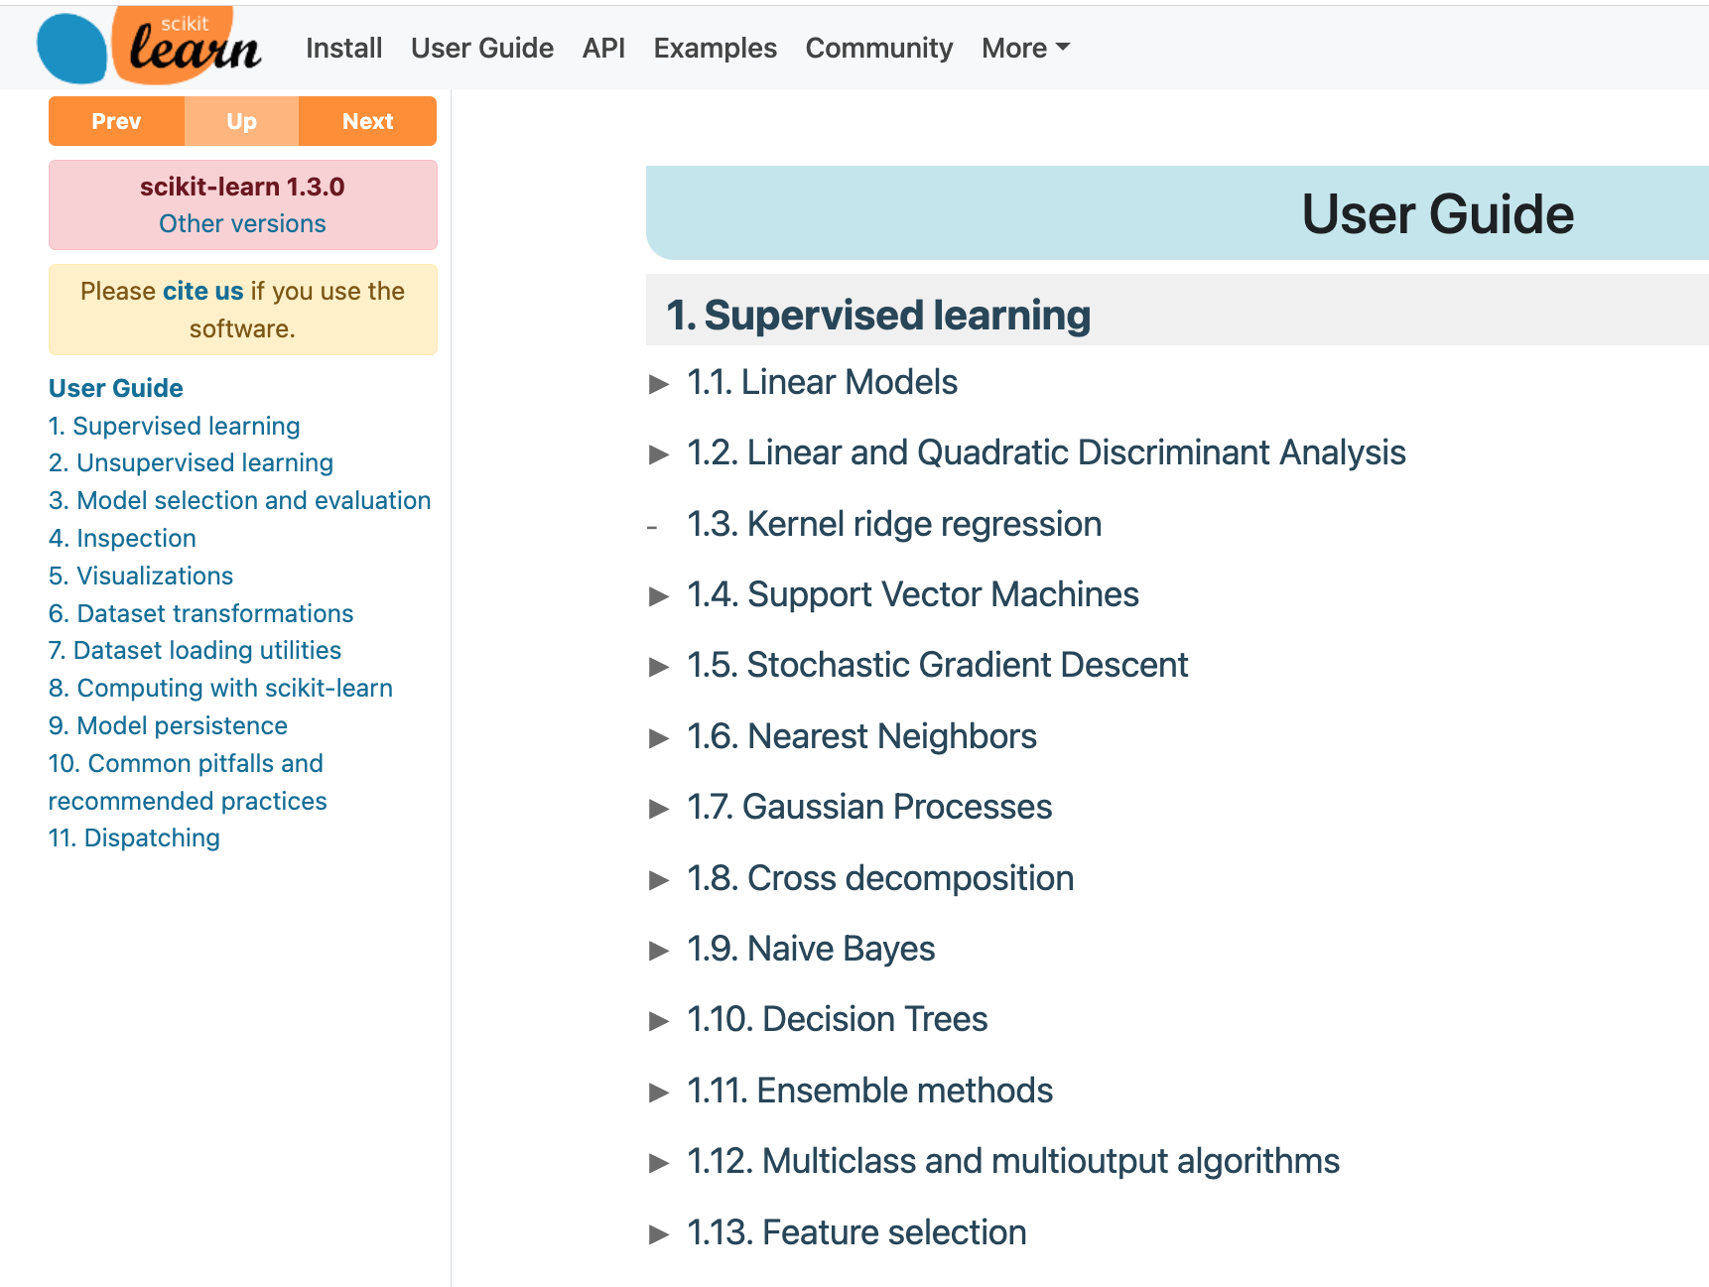
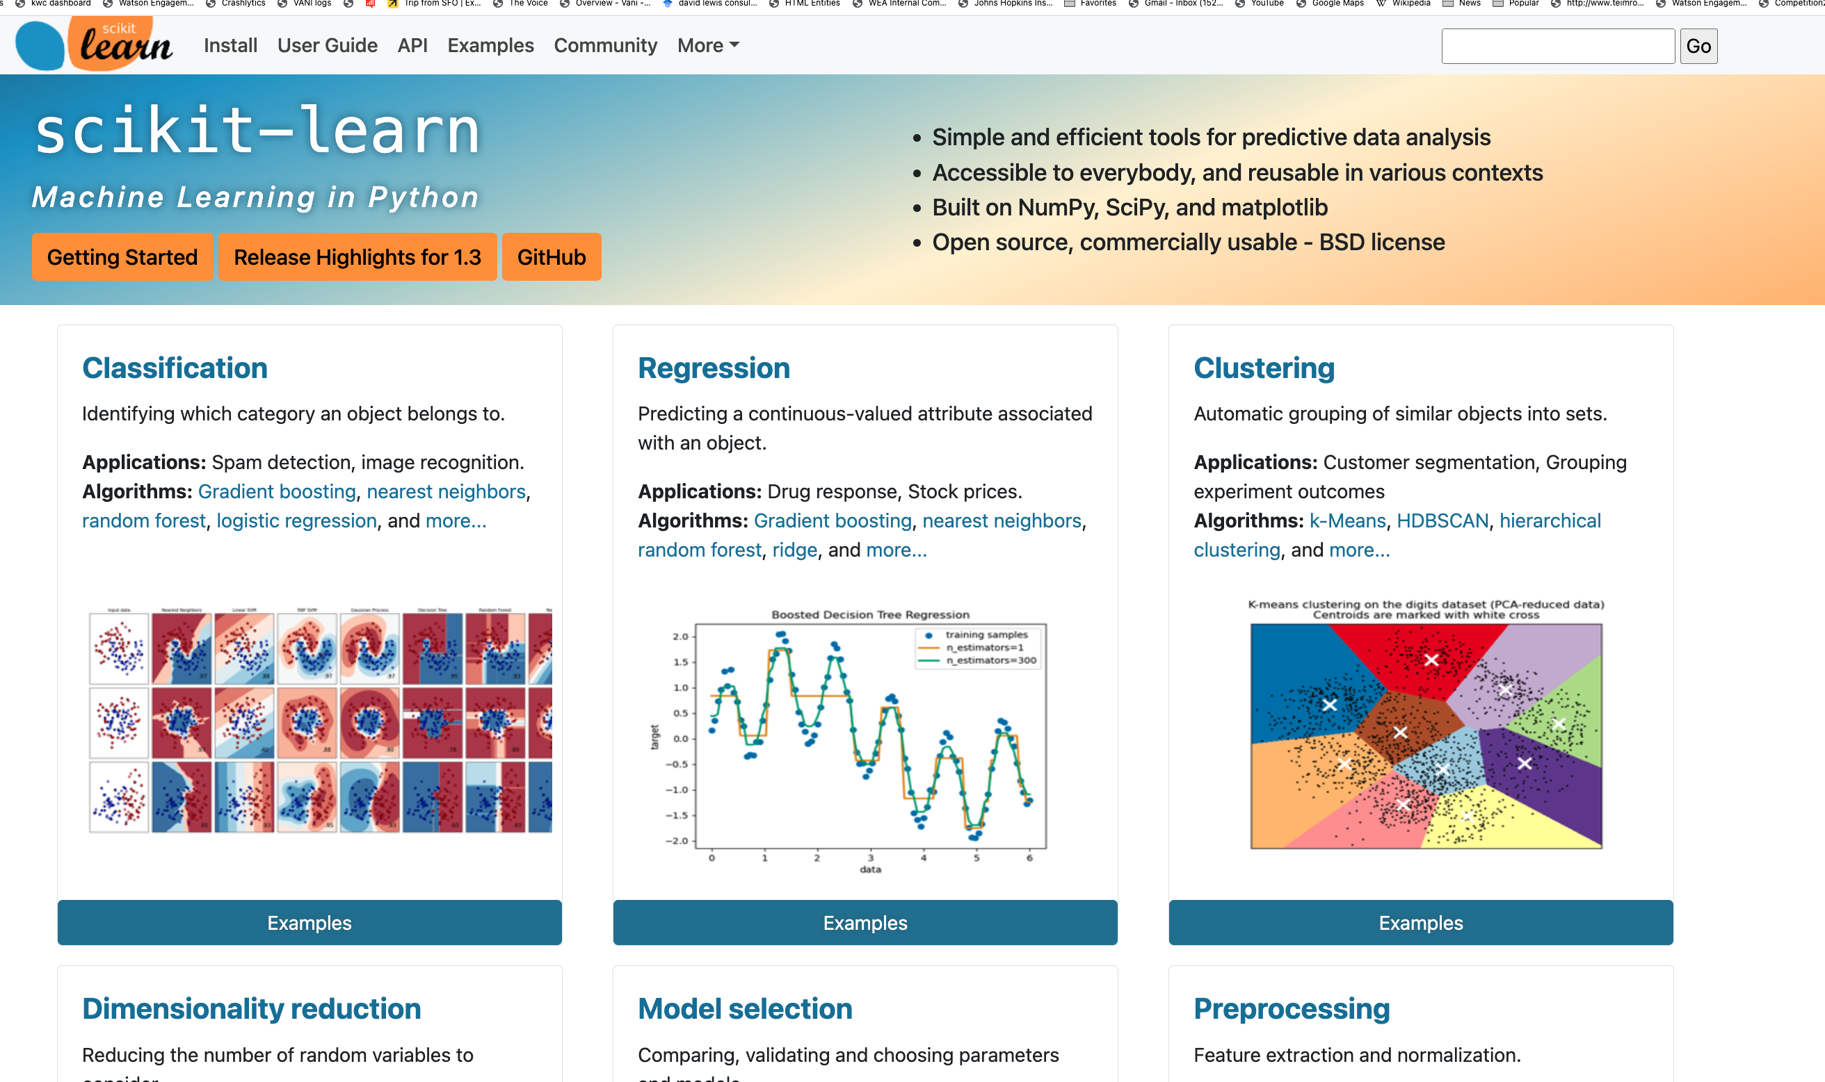
Sklearn

Slide 36
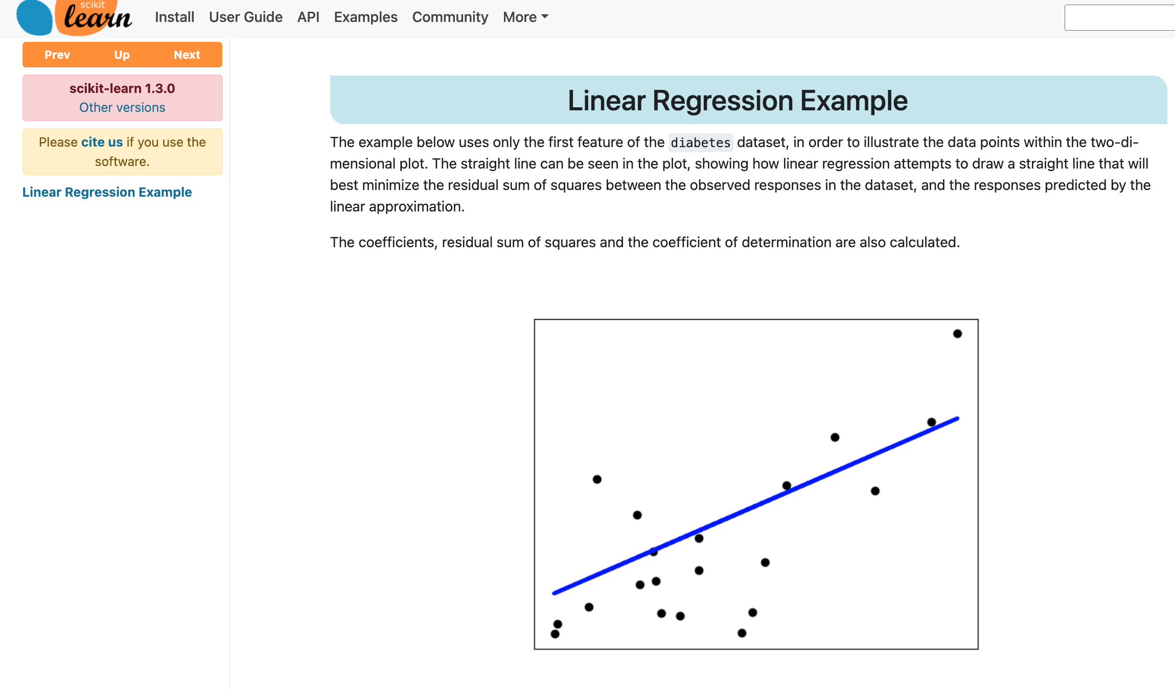

Slide 37
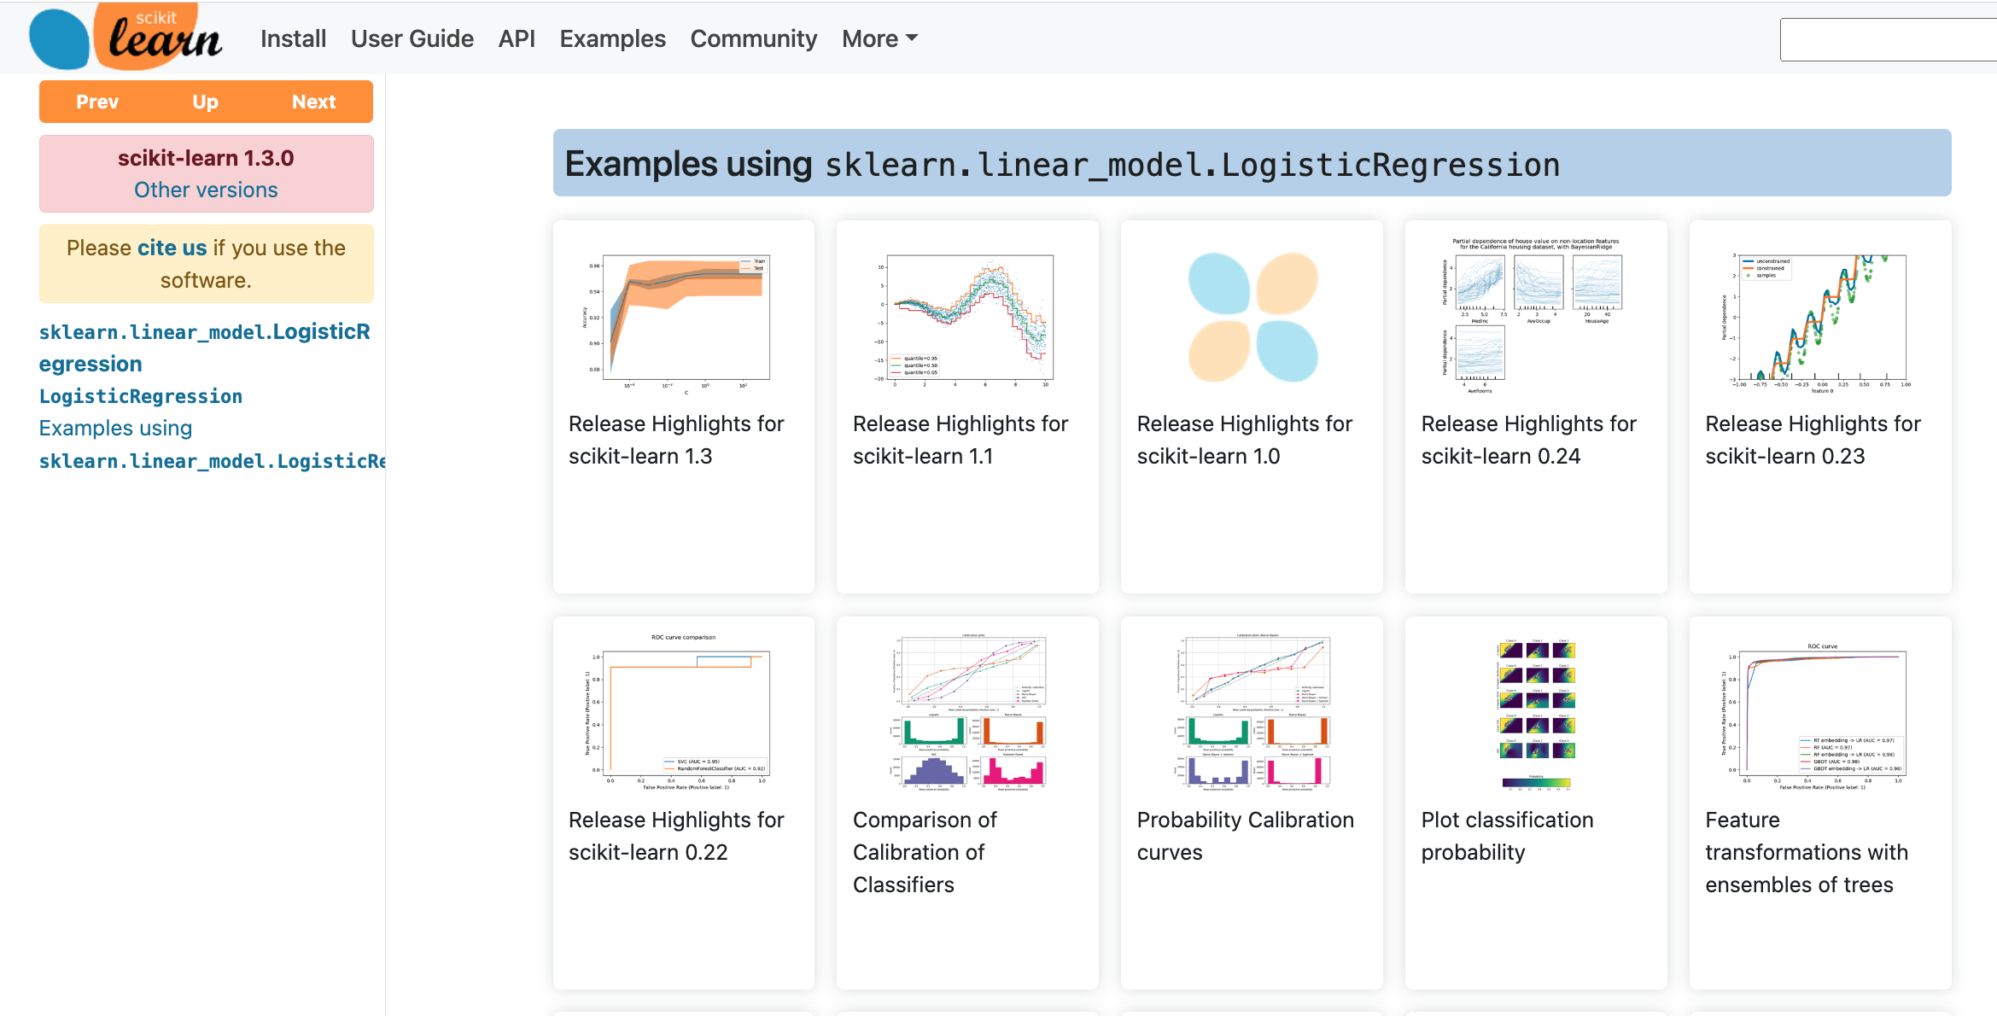

Slide 38
Linear Regression and Logistic Regression
Linear
g1 = glm(dist ~ poly(speed,2), data=cars)
Logistic
g2 = glm(dist > 50 ~ poly(speed,2), data=cars, family=binomial)
Models
> g1$coef
(Intercept) poly(speed, 2)1 poly(speed, 2)2
42.98000 145.55226 22.99576
> g2$coef
(Intercept) poly(speed, 2)1 poly(speed, 2)2
-1.137922 16.172581 2.031136

Slide 39
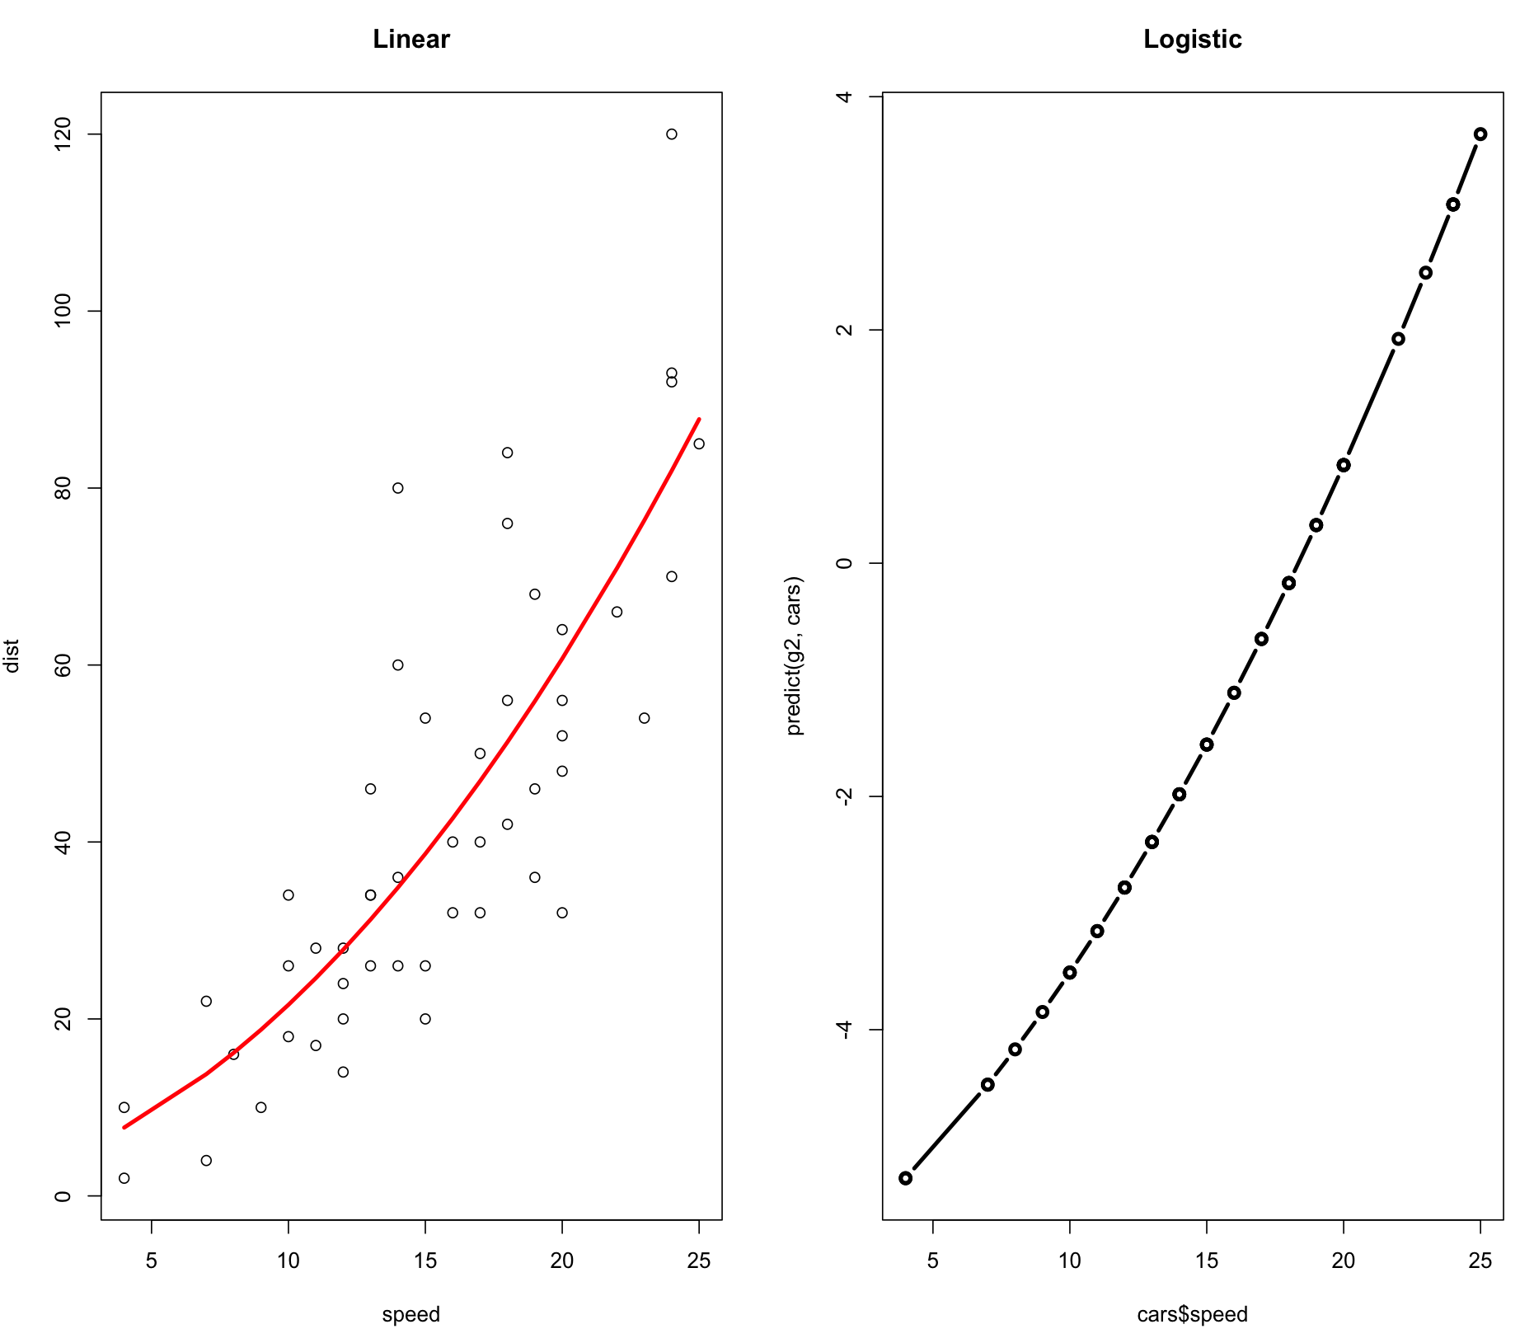
Linear and Logistic Regression
> g1 = glm(dist ~ poly(speed,2), data=cars)
> g2 = glm(dist > 50 ~ poly(speed,2), data=cars, family=binomial)
> plot(cars, main="Linear")
> lines(cars$speed, predict(g1, cars), col="red", lwd=3)
> plot(cars$speed, predict(g2, cars), type='b', lwd=3, main="Logistic")

Slide 40
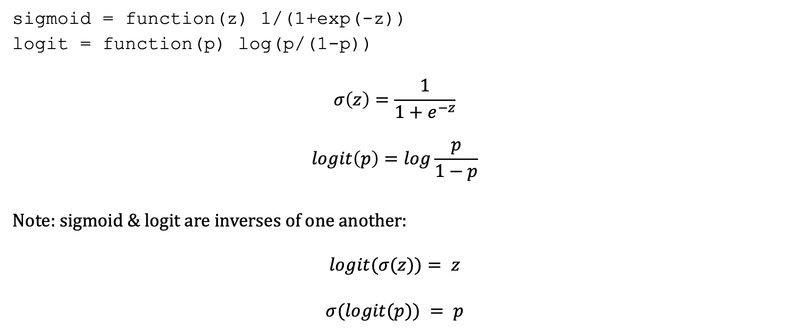
Inverses
sigmoid = function(z) 1/(1+exp(-z))
logit = function(p) log(p/(1-p))
$$σ\left(z\right)=\frac{1}{1+e^{−z}}$$
$$logit\left(p\right)=log\frac{p}{1−p}$$
Note: sigmoid & logit are inverses of one another:
$$logit(σ(z))= z$$
$$σ(logit(p)) = p$$

Slide 41
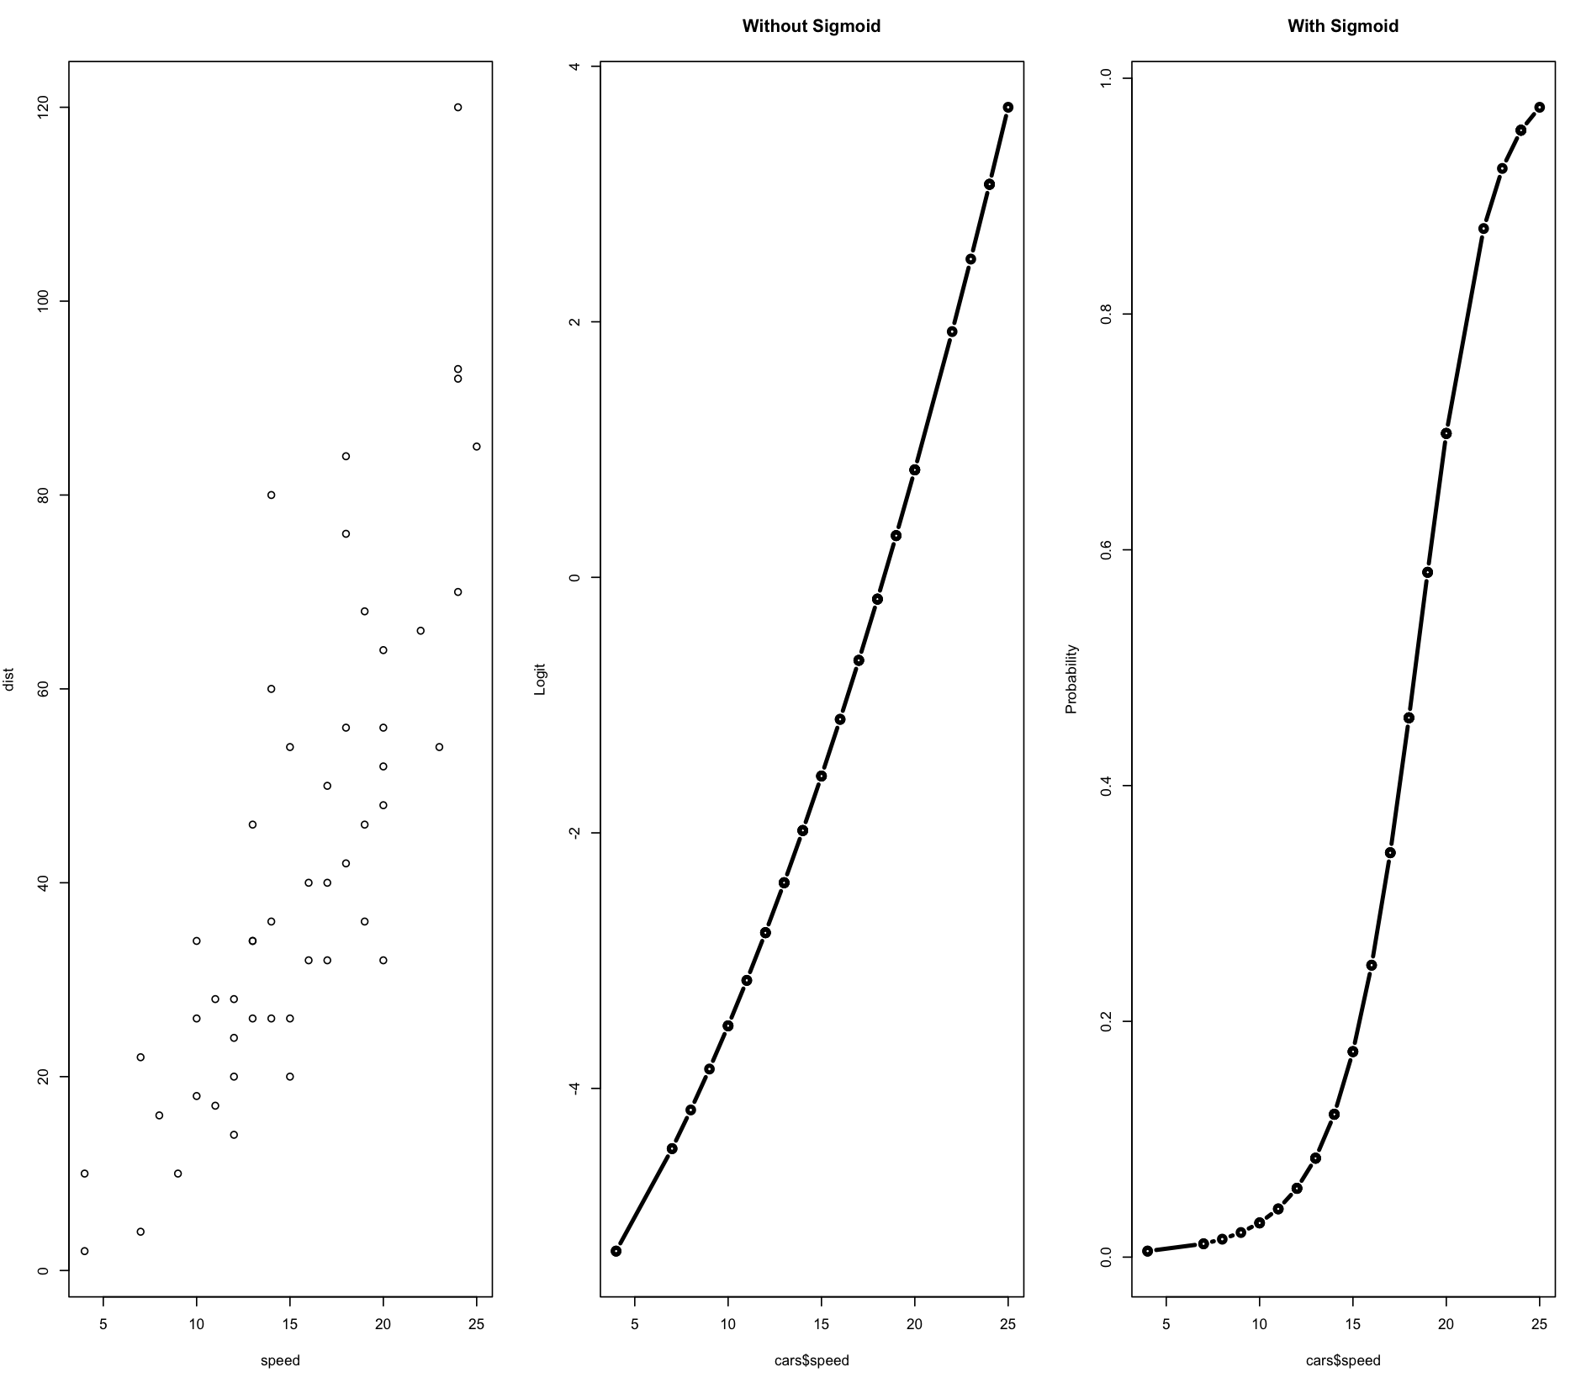
Linear and Logistic Regression
> g1 = glm(dist ~ poly(speed,2), data=cars)
> g2 = glm(dist > 50 ~ poly(speed,2), data=cars, family=binomial)
> plot(cars$speed, predict(g2, cars), type='b', lwd=3, main="Without Sigmoid", ylab="Logit")
> plot(cars$speed, sigmoid(predict(g2, cars)), type='b', lwd=3, main="With Sigmoid", ylab="Probability")

Slide 42
Recap
What’s where:
https://kwchurch.github.io/
Formalities:
Northeastern Rules, Culture, etc.
Instructors, TA, Office Hours
Goals, Expectations, etc.
Encouraging learning:
Teamwork, Online Resources, Bots
As long as these tools → learning
Grading:
Assignments:
Effort/Learning >> Solving Problems
Mid-Term Exam:
Open book, network
But no teams
Final Project: Proposal, Oral, Written
Better Together Homework
Little Languages: Unix, AWK, R
Deep Nets
Inference (predict)
Fine-Tuning (fit)
Pre-training
aka base/fundamental models
(don’t do it)
Deep nets are like regression
Linear regression:
Cars example: fit/predict in R
Datasets:
cars dataset in R is like
emotion dataset on huggingface
Classification vs. Regression
Logistic Regression: example of binary classification
Similarities of linear and logistic regression

Slide 43
Recap
What’s where:
https://kwchurch.github.io/
Formalities:
Northeastern Rules, Culture, etc.
Instructors, TA, Office Hours
Goals, Expectations, etc.
Encouraging learning:
Teamwork, Online Resources, Bots
As long as these tools → learning
Grading:
Assignments:
Effort/Learning >> Solving Problems
Mid-Term Exam:
Open book, network
But no teams
Final Project: Proposal, Oral, Written

Slide 44
Recap
What’s where:
https://kwchurch.github.io/
Formalities:
Northeastern Rules, Culture, etc.
Instructors, TA, Office Hours
Goals, Expectations, etc.
Encouraging learning:
Teamwork, Online Resources, Bots
As long as these tools → learning
Grading:
Assignments:
Effort/Learning >> Solving Problems
Mid-Term Exam:
Open book, network
But no teams
Final Project: Proposal, Oral, Written

Slide 45
SciPy

Slide 46
gft Design Goals
Inclusiveness:
Accessible to Masses
(including non-programmers)
Portability
Ease-of-Use/Transparency >> SOTA
Hide Complexity/Magic (Alchemy)
No one would suggest
Regression-like methods are ``intelligent’’

Slide 47
Portability: Inclusiveness + Hedge
gft Programs
H → HuggingFace
gft_fit --model H:bert-base-cased \
--data H:emotion \
--output_dir $1 \
--eqn 'classify: label ~ text'
Hedge
(Supply Chains)
Hedge
(Supply Chains)
P → PaddleNLP
gft_fit --model P:ernie-tiny \
--data P:chnsenticorp \
--output_dir $1 \
--eqn 'classify: label ~ text'
Emphasis on Chinese

Slide 48
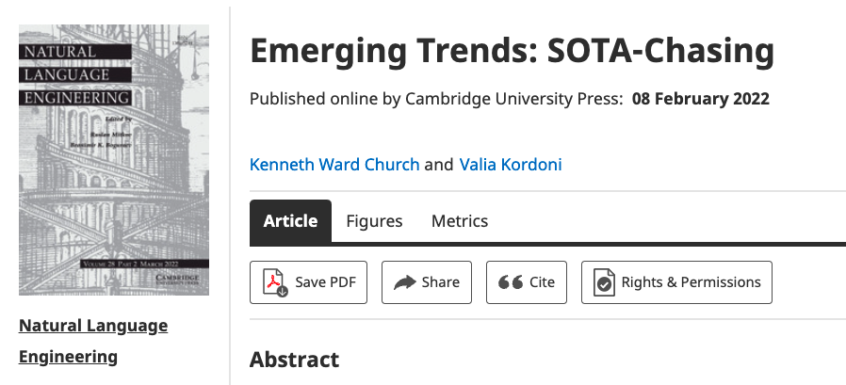
Strategy: Inclusiveness
Get your priorities right: Inclusiveness >> Exclusiveness
SOTA-Chasing 👎 (Exclusive: mine is bigger than yours)
Crossing the Chasm 👍 (Inclusive: Appeal to mainstream users)
Hubs: Get big quick 👍 (Inclusive: Usage >> SOTA)

Slide 49
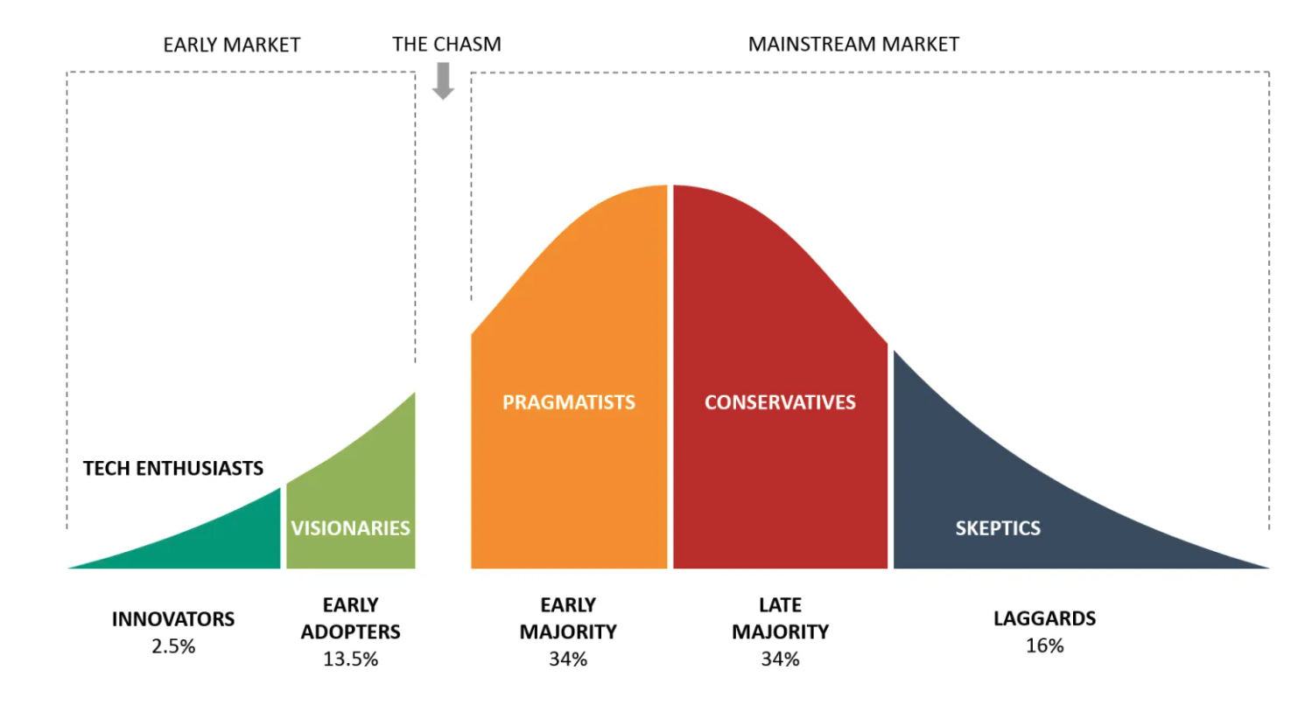
Bigger Opportunities:
(l)users (aka poets)
Engineers

Slide 50
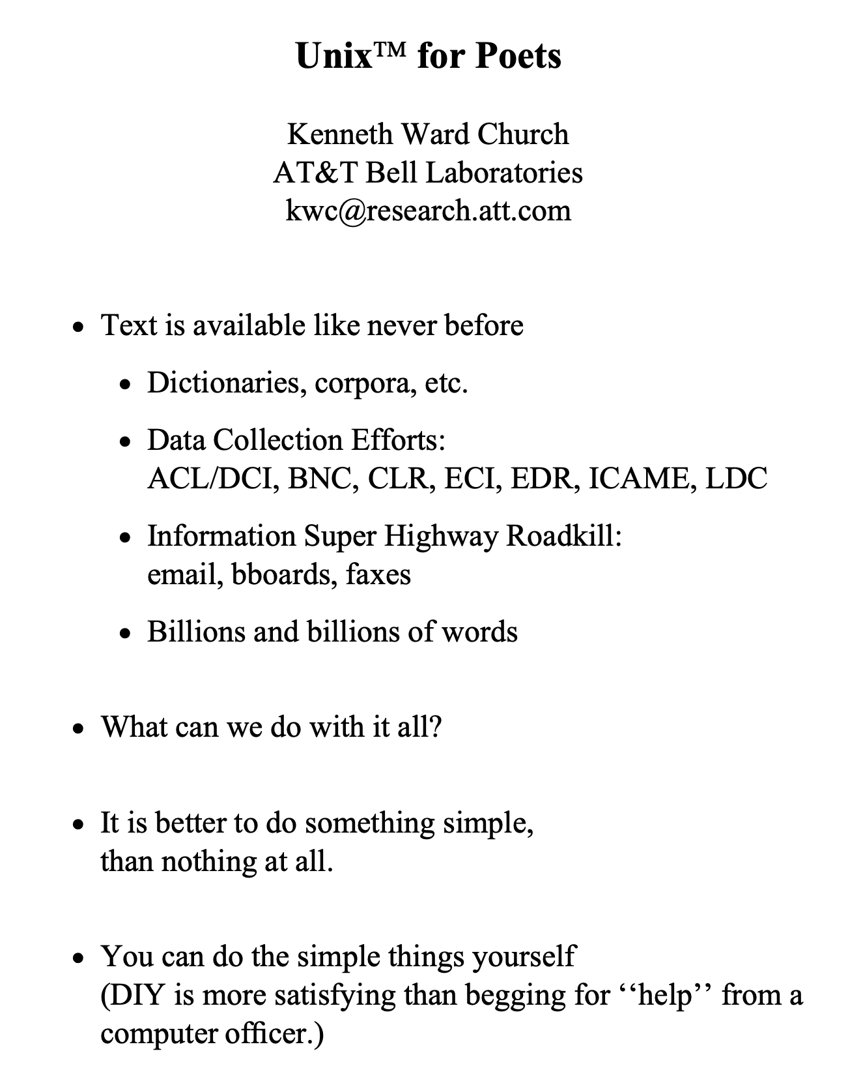
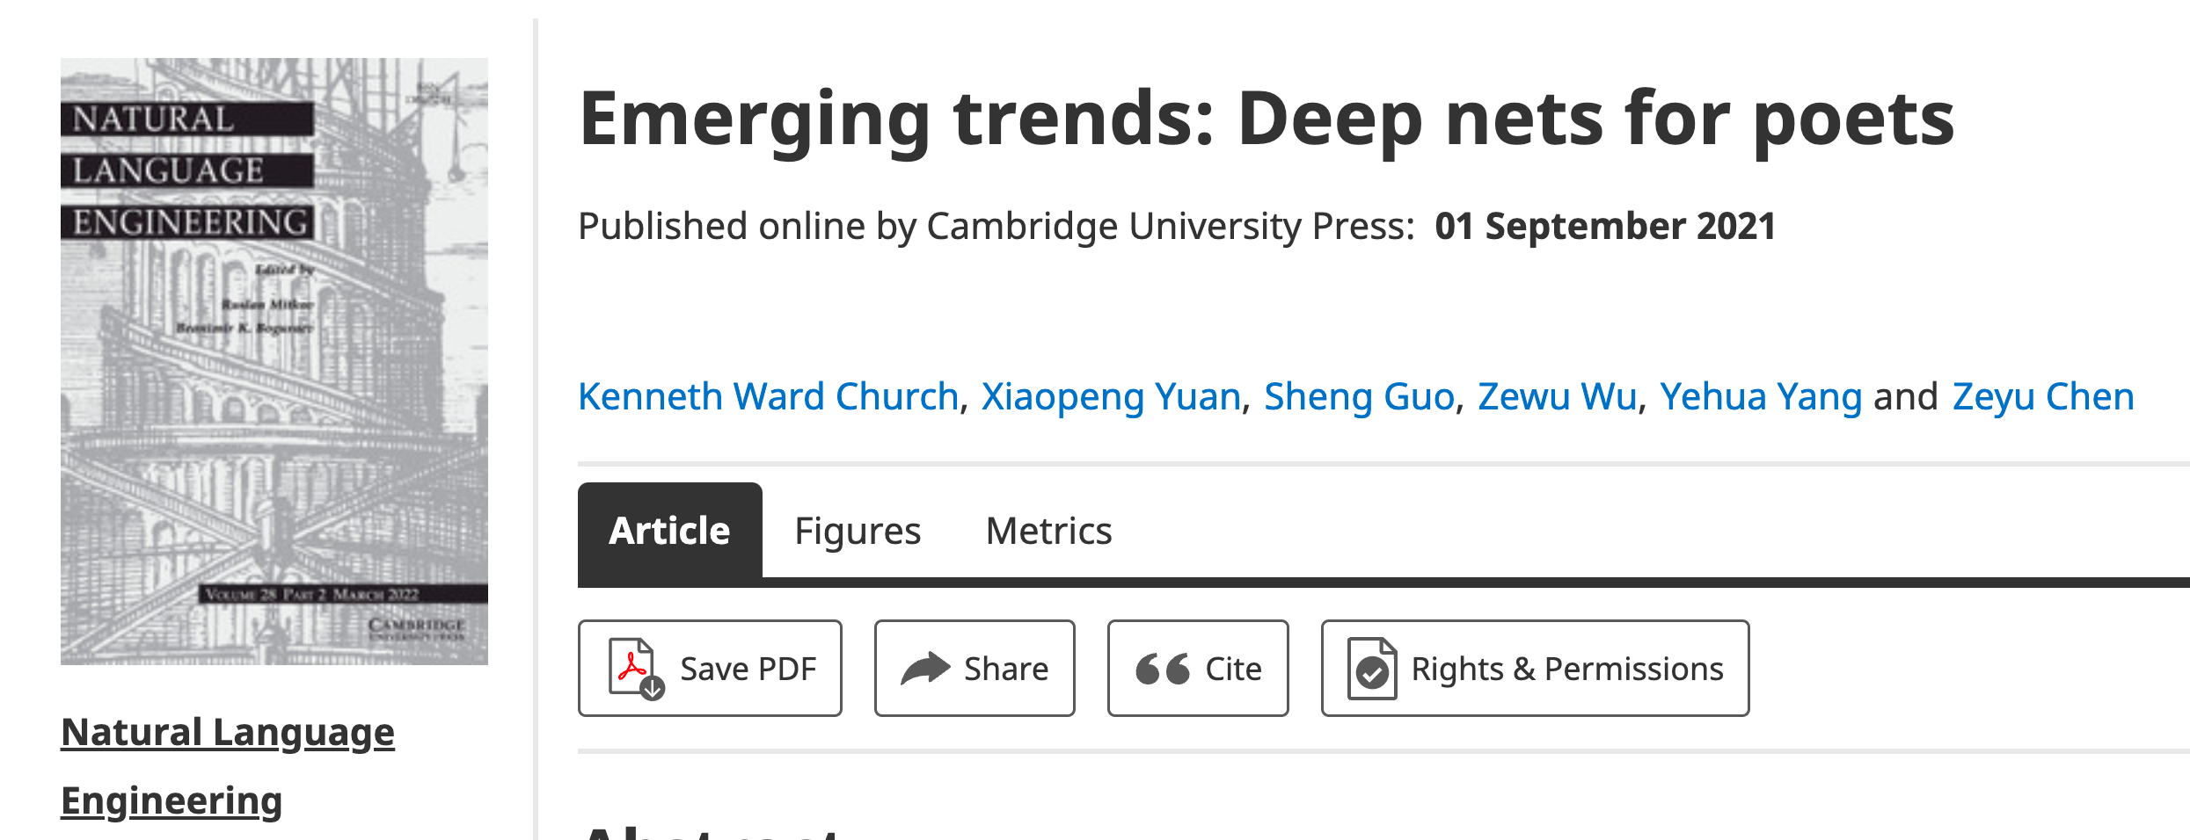
Poets
Poets is an imperfect metaphor,
intended as a gesture toward inclusion.
The future for deep nets
will benefit by reaching out to
a broad audience of potential users,
including people with
little or no programming skills,
and little interest in training models.
Lessons from success of Unix
Less is more
Inclusion: Appeal to power users as well as masses
Portability: Inclusiveness++

Slide 51
Hub Strategy: Usage >> SOTA
(Sensible) Priority for Startups
(Mistaken) Priority Research
Startup Strategy:
Get big quick
SOTA is like sprinting (hard work)
Avoid temptation to sprint to front
(except when it is worth the effort)
Hubs spend most of the race
in the peloton drafting researchers
Make it easy for 3rd parties
to post their best models on your hub
Use of 3rd parties → Wide range in quality
Best are amazing: best in class, industrial strength…
But some don’t work well, and may not even load…
Help users find good stuff & embrace community

Slide 52

Two Perspectives on Datasets
Machine Learning
Psychology (Presupposes $∃$Hypothesis)
Splits: train/val/test
Treat rows as iid
Identical and independently distributed
Idealistic, but maybe unrealistic
Changes over time, Context, etc.
More papers on models
than Datasets
Relatively little interest in
Is the Dataset Realistic?
Motivation? (Does anyone care? If so, who?)
What is the dataset testing?
Sampling/balance? From which population?
Can it be gamed? Leakage?
Validity
Content validity
Construct validity
Criterion validity
Face validity
Discriminant validity
Reliability
Inter-rater reliability
Test-retest reliability
Internal reliability/Inter-item consistency
Split half reliability
Lexicography

Slide 53
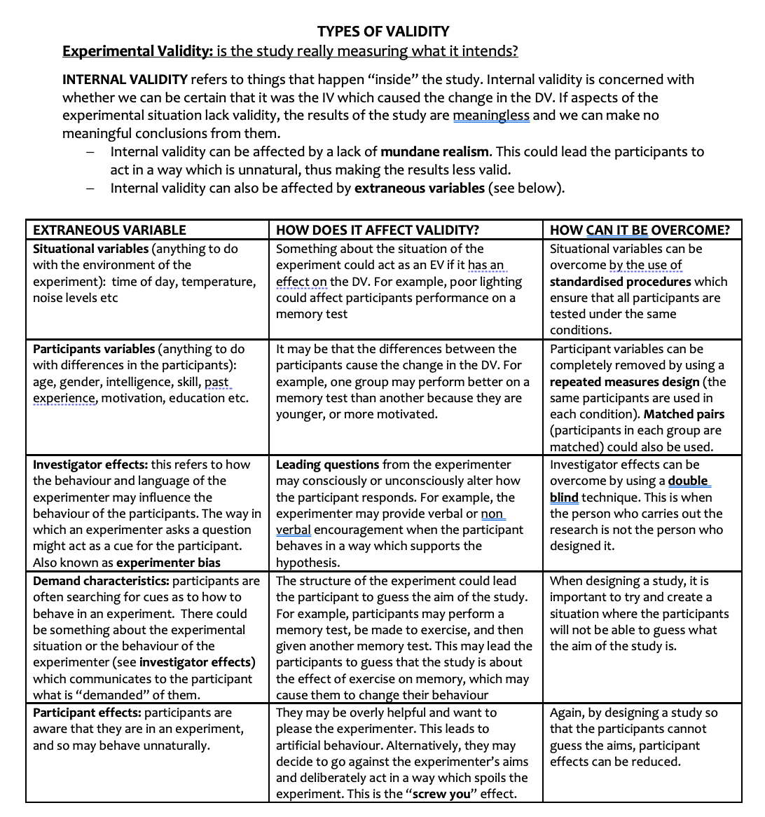
Discussion of Validity Assumes: Intention

Slide 54
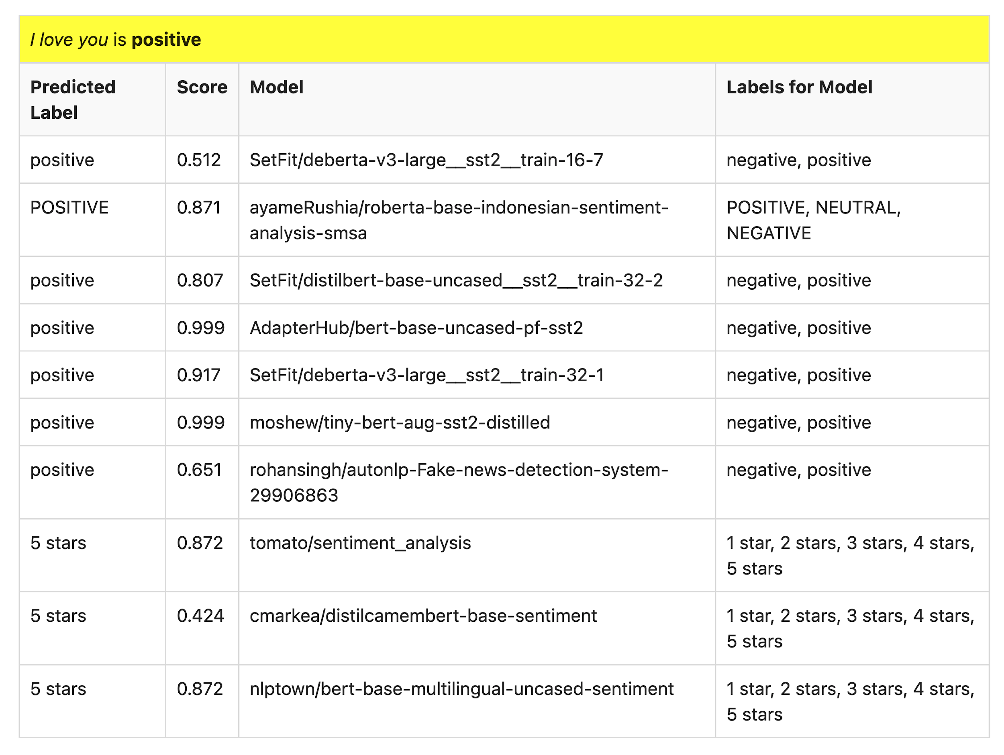
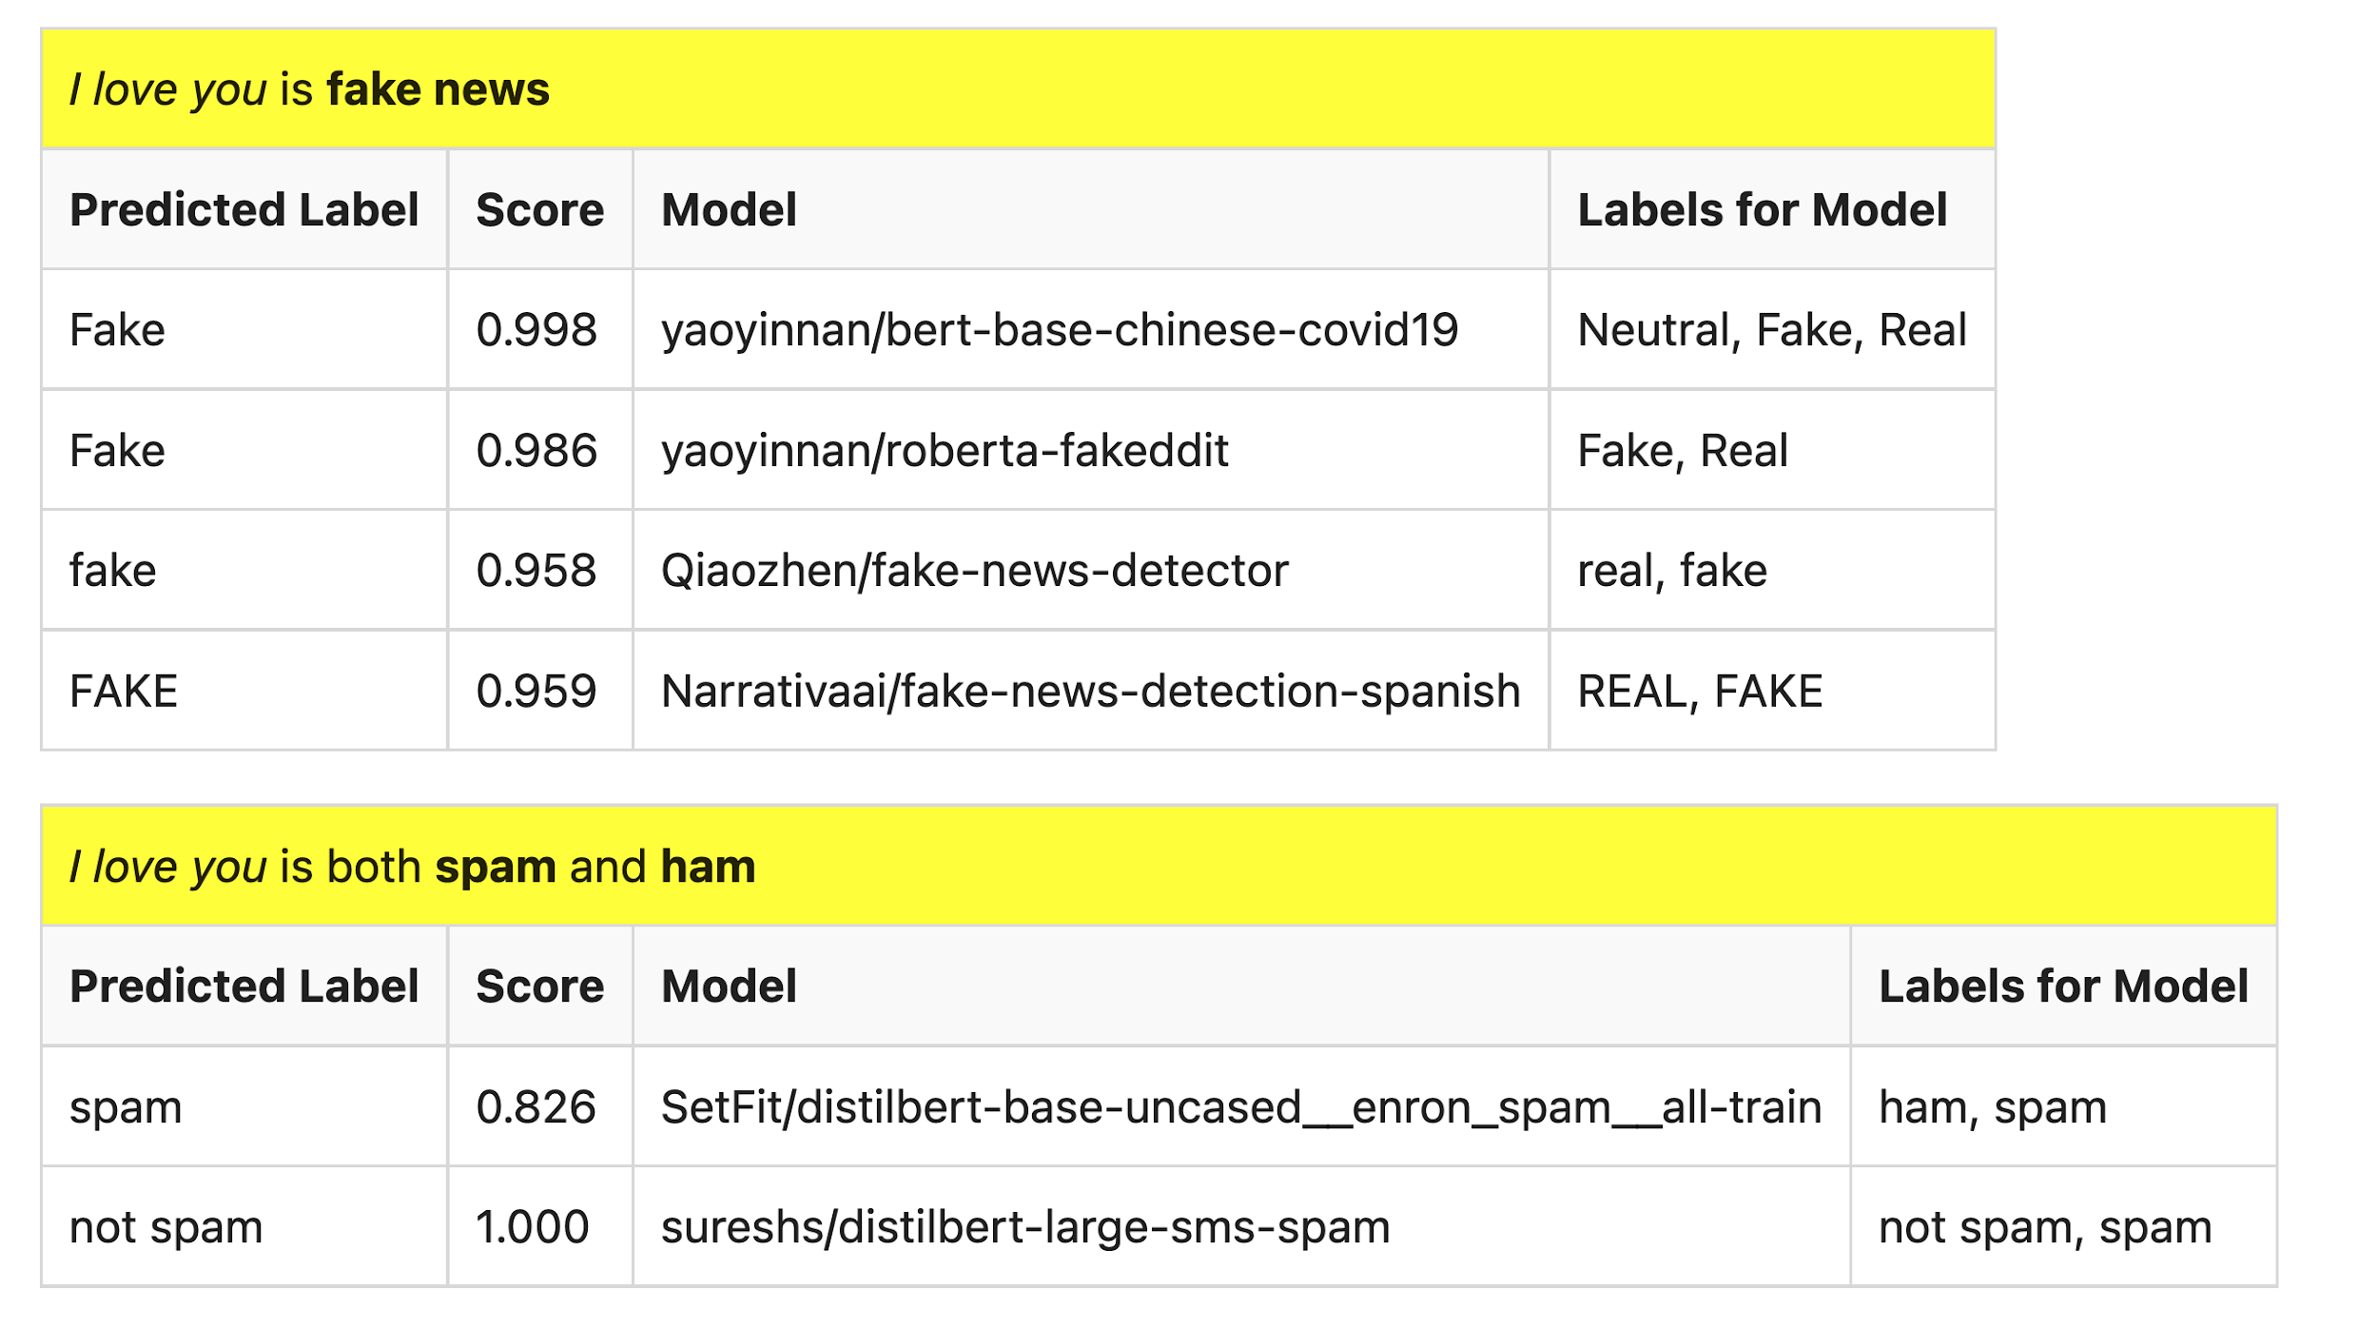
Many of these models produce reasonable results
Scores could be more confident

Slide 55
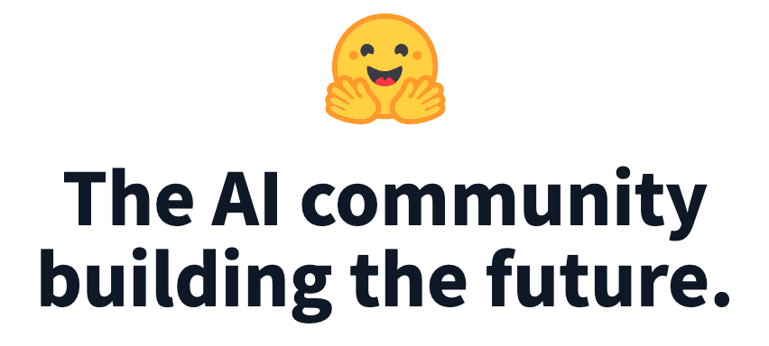
Lots of Models on Hubs (for lots of tasks)
Natural Language
Classification
Sentiment: positive/negative, 1-5 stars
Emotion classification
Hate speech classification
Guess missing word (fill-mask; cloze task)
Part of speech tagging
NER (named entity recognition)
Question Answering (SQUAD)
Entailment (GLUE)
Image Classification
Speech recognition
Machine Translation
Examples of fill-mask
echo … | gft_predict --task fill-mask
I <mask> you
miss|0.295
love|0.174
salute|0.158
I love the <mask> guy
pizza|0.035
funny|0.016
old|0.010
Examples of machine translation
echo …| gft_predict --task translation \
--model H:Helsinki-NLP/opus-mt-en-fr
I love you
Je t'aime.
2k translation models
on HuggingFace

